Slide 1
Cost of Budget
Project Management

Slide 2
Earn Value Management
Biaya yang dianggarkan | Rp 720.000
Biaya Aktual | Rp 800.000
Perbedaan (Variansi) | Rp 80.000
Akumulasi Biaya yang dianggarkan sampai bulan ini | Rp30.000.000
Akumulasi biaya aktual sampai bulan ini | Rp31.000.000
Perbedaan (variansi) | Rp 1.000.000

Slide 3
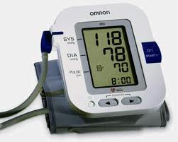
Earn Value Management
Measure the health of a project
to communicate the progress of the works.
Measure in monetary terms

Slide 4
Earn Value Management
a standard means of objectively measuring work accomplished by integrating cost, schedule and technical performance into one set of metrics so that effective comparisons can be made.

Slide 5
Earn Value Management
Budgeted Cost for Work Scheduled (BCWS) or Planned Value/PV - the budgets for all activities planned to be completed.
Actual Cost of Work Performed (ACWP) or Actual Cost/AC - the real costs of the work charged against the completed activities.
Budgeted Cost of Work Performed (BCWP) or Earned Value/EV- the planned costs of the work allocated to the completed activities. This is the Earned Value.

Slide 6
Earn Value Management
Earned Value =
Percentage project complete (%) X Project Budget (PV)
AV (Accounting Variances) = PV – AC
SV (Schedule Variances) =EV– PV
CV (Cost Variances) = EV – AC
TV (Time Variances) = Status Date/Time Now – BCSP
BCSP: Budgeted Cost when BCSP = EV
(Biaya yang dianggarkan saat BCSP = EV)

Slide 7
SPI & CPI
Schedule Performance Index, SPI = EV/PV
Cost Performance Index, CPI = EV/AC
Jika SPI & CPI > 1, menyatakan bahwa pekerjaan lebih cepat dan lebih murah.
Jika SPI & CPI < 1, menyatakan bahwa pekerjaan lebih lambat dan lebih mahal. anggaran.

Slide 8
Forecasted and Budgeted Cost
Anggaran yang tersisa untuk menyelesaikan proyek = Biaya total – biaya yang sudah terpakai /Atau anggaran yang tersisa = BAC – EV.
BAC: Budgeted Cost at Completion (Biaya yang dianggarkan pada saat proyek selesai).
Sedangkan perkiraan biaya untuk pekerjaan tersisa = anggaran tersisa / indeks performansi biaya atau FCTC = (BAC – EV) / CPI
FCTC : Forecasted Cost to Complete.
Besarnya BAC sama dengan PV pada saat proyek ditargetkan selesai

Slide 9
Forecasted and Budgeted Cost
Perkiraan total biaya proyek = biaya yang sudah dihabiskan + perkiraan biaya untuk pekerjaan tersisa EAC = AC + FCTC.
EAC : Estimated at Completion (perkiraan total biaya proyek).

Slide 10
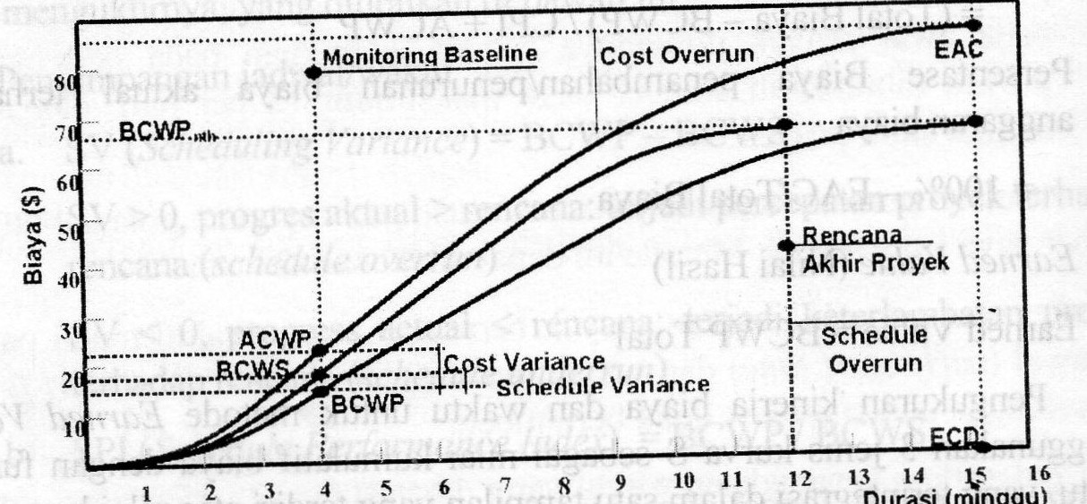
Jenis Kurva S

Slide 11
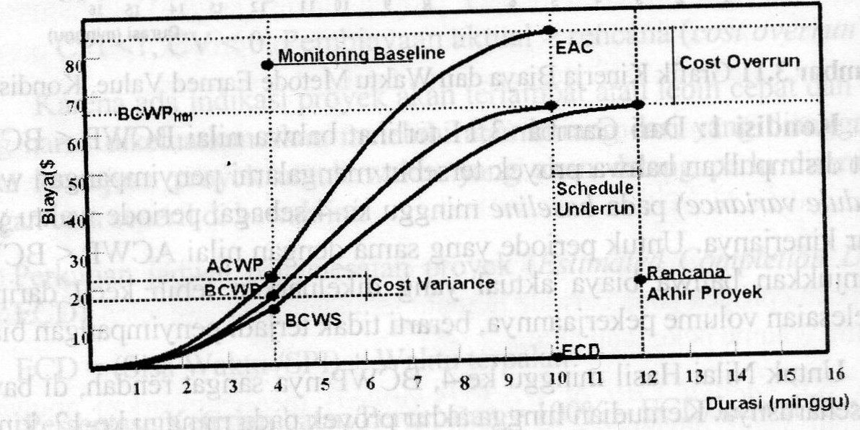

Slide 12
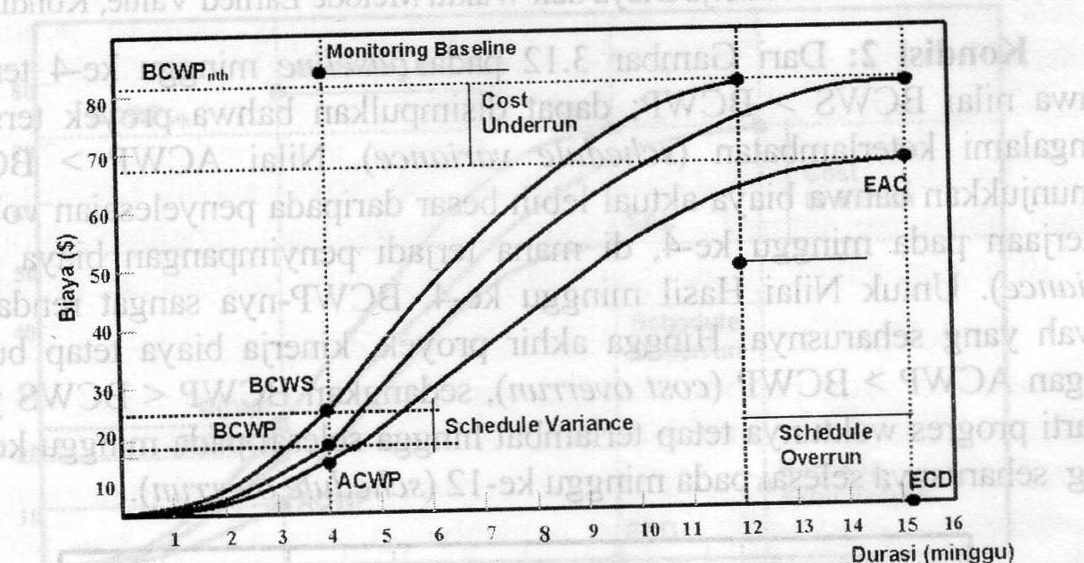

Slide 13
