Slide 1
Project Stakeholder Management
PMI (2013), Schwalbe (2013)

Slide 2
Definition
“Project stakeholders are individuals, groups, or organizations who may affect, be affected by, or perceive themselves to be affected by a decision, activity, or outcome of a project.”

Slide 3
Introduction
Stakeholders are an important part of the project management framework.
Stakeholders request projects, approve them, reject them, support them, and oppose them
Most stakeholders are not aware of and don’t care about other stakeholders
Project managers and their teams must have a good dialogue with them
Giving appropriate communication channel

Slide 4
Introduction
internal
external
project sponsor, project
team, support staff, and internal customers for the project.
top management, other functional managers,
competitors, suppliers,
Groups government officials and concerned citizens.

Slide 5
Introduction
Program director
Program manager
Project manager
Project manager’s family
Sponsor
Customer
Performing organization
Other employees of the organization
Labor unions
Project team members
Project management office
Governance board
Suppliers
Governmental regulatory agencies
Competitors
Potential customers with an interest in the project
Groups representing consumer, environmental, or other interests
Groups or individuals who are competing for limited resources
Groups or individuals who are pursuing goals that conflict with those of the project2

Slide 6
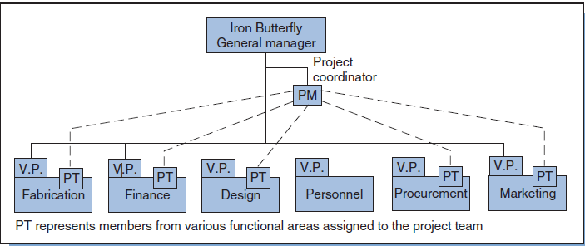

Slide 7
Project Stakeholder Management
Monitoring &
Controlling Processes
Planning
Processes
Enter phase/
Start project
Initiating
Processes
Closing
Processes
Exit phase/
End project
Executing
Processes
Knowledge Area | Process
 | Initiating | Planning | Executing | Monitoring & Contol | Closing
Communication | Indentify Stakeholder | Plan stakehodler management | Manage engagement | Monitoring stakeholder engagement

Slide 8
13.1 Identify Stakeholder
The process of identifying all people or organizations impacted by the project, and documenting relevant information regarding their interest, involvement, and impact on project success.
Inputs
Project charter Procurement documents Enterprise environmental factors Organizational process assets
Tools & Techniques
Stakeholder analysis Expert judgment meetings
Outputs
Stakeholder register

Slide 9
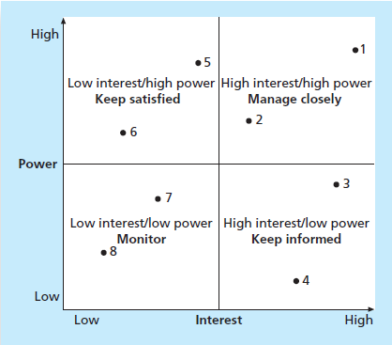
Stakeholder Analysis
A technique of systematically gathering and analyzing quantitative & qualitative information to determine whose interests should be taken into account throughout the project.
Step 1: Identify all potential project stakeholders and relevant information
Step 2: Identify the potential impact or support each stakeholder could generate and classify them so as to define an approach strategy.
Step 3: Assess how key stakeholder are likely to react or respond in various situation
Sample grid showing classification model

Slide 10
Output of Identify Stakeholder
Stakeholder Register
Name | Contact Information | Role in Project | Department/ Supervisor | Company | Impact | Influence | Main expectations | Attitude about the project | Major requirement
Stakeholder Management Strategy
Defines an approach to increase the support and minimize negative impacts of stakeholder.
The information could be too sensitive to be shared.
A common way of representing is by using a stakeholder analysis matrix.
Stakeholder | Stakeholder interest(s) in the project | Assessment of impact | Potential strategies for gaining support or reducing obstacles

Slide 11
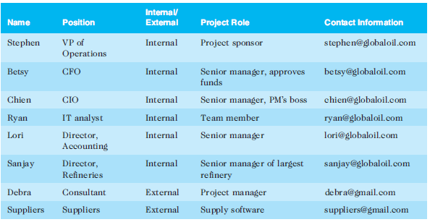
Stakeholder register

Slide 12
Salience Model

Slide 13
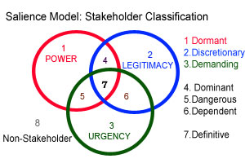
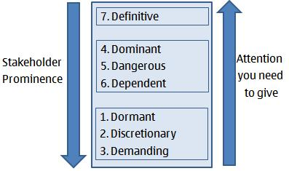

Slide 14
Say no to “stakeholder”
Bring a facts
Do a reasearch
Give proper
explanation

Slide 15
13.2 Plan Stakeholder Management
Determining strategies to effectively engage stakeholders in project decisions and activities based on their needs, interests, and potential impact.
Inputs
Project management plan Stakeholder register Enterprise environmental factors Organizational process assets
Tools & Techniques
Meetings Expert judgment Analytical techniques
Outputs
Stakeholder management plan Project document update

Slide 16
13.2 PlanStakeholder Management
Current and desired engagement levels
Interrelationships between stakeholders
Communication requirements
Potential management strategies for each stakeholder
Methods for updating the stakeholder management plan
it should not be part of the official project documents
In many cases, parts of the stakeholder management plan are not written down, and if they are, distribution is strictly limited.

Slide 17
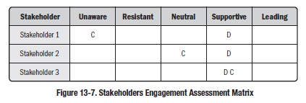
13.2 Plan Stakeholder Management
Analytical techniques
Unaware: Unaware of the project and its potential impacts on them
Resistant: Aware of the project yet resistant to change
Neutral: Aware of the project yet neither supportive nor resistant
Supportive: Aware of the project and supportive of change
Leading: Aware of the project and its potential impacts and actively engaged in helping it succeed

Slide 18
13.3 Manage Stakeholder Management
communicating and working with project stakeholders to satisfy their needs and expectations, resolving issues, and fostering engagement in project decisions and activities.
Inputs
Stakeholder management plan Communication management plan Change log Organizational process assets
Tools & Techniques
Communication method Interpersonal skills Management skills
Outputs
Issue log Change request Project management plan update Project document update Organizational process assets update

Slide 19
Manage Stakeholder Management
Project managers must understand and work with various stakeholders
use various communications methods and their interpersonal and management skills to engage stakeholders

Slide 20
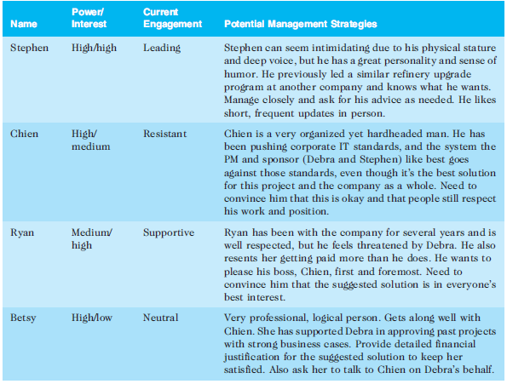
Stakeholder Analysis

Slide 21
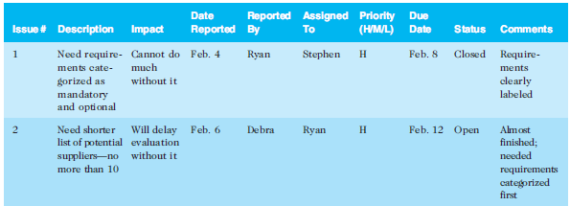
Issue log

Slide 22
13.4 Control Stakeholder Management
Monitoring stakeholder relationships and adjusting plans and strategies for engaging stakeholders as needed.
Inputs
Project management plan Work performance data Issue log Project documents
Tools & Techniques
Information management system Expert judgement Meetings
Outputs
Work performance information Change request Project management plan update Project document update Organizational process assets update
You cannot control stakeholders,
but you can control their level of engagement.

Slide 23
Control Stakeholder Management
Key stakeholders should be invited to actively participate in a kick-off meeting rather than merely attending it
Software can also assist in project stakeholder management
Communications software like e-mail, blogs, Web sites, texts, and tweets can aid in stakeholder communications. (Avoid the typo)
Collaboration tools like Google docs, wikis, and virtual meeting software can also promote stakeholder engagement in projects

