Slide 1
Project Communication Management
Schwalbe (2013), PMI (2013)

Slide 2
Introduction
The greatest threat to the success of any project, especially IT projects, is a failure to communicate
Project managers say they spend as much as 90 percent of their time communicating.
People have different personality traits that often affect their communication preferences

Slide 3
Introduction
Geographic location and cultural background also affect the complexity of project communications.
75 percent of the general population are extroverts, so they enjoy talking to other people.
Face-to face meeting is the most effective communication than written
The most important thing is body language

Slide 4
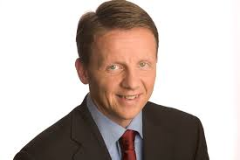
Vice president of marketing at a large Silicon Valley company (2004), decreed that Fridays would be e-mail free in his department.
The 240 people in his department had to use the phone or meet face to face with people, and violators who did use e-mail were fined.

Slide 5
Project Communication
The process required to ensure timely and appropriate generation, collection, distribution, storage, retrieval, and ultimate disposition of project information.

Slide 6
Project Communication Management
Monitoring &
Controlling Processes
Planning
Processes
Enter phase/
Start project
Initiating
Processes
Closing
Processes
Exit phase/
End project
Executing
Processes
Knowledge Area | Process
 | Initiating | Planning | Executing | Monitoring & Contol | Closing
Communication |  | Plan Communication | Manage Communication | Control Communication

Slide 7
Project Communication Management
Project managers spend the majority of their time to communicate.
Some potential dimensions of communication activity:
Internal – external
Formal – informal
Vertical – horizontal
Official – unofficial
Written – oral
Verbal –non-verbal
Informal communication can increase the trust in a relationship
oral communication build stronger relationship

Slide 8
“the difference between good project managers and excellent project managers is their ability to nurture relationships and use empathic listening skills”

Slide 9
Communication dimension
writing
speaking
Listening
Project personal

Slide 10
10.2 Plan Communication
The process of determining the project stakeholder information needs and defining a communication approach.
Inputs
Project Management plan Stakeholder register Enterprise environmental factors Organizational process assets
Tools & Techniques
Communication requirement analysis Communication technology Communication models Communication methods meetings
Outputs
Communication management plan Project document updates
What communication must be prepared

Slide 11
Output of Identify Stakeholder
Stakeholder Register
Name | Contact Information | Role in Project | Department/ Supervisor | Company | Impact | Influence | Main expectations | Attitude about the project | Major requirement
Stakeholder Management Strategy
Defines an approach to increase the support and minimize negative impacts of stakeholder.
The information could be too sensitive to be shared.
A common way of representing is by using a stakeholder analysis matrix.
Stakeholder | Stakeholder interest(s) in the project | Assessment of impact | Potential strategies for gaining support or reducing obstacles

Slide 12
Communication Requirement Analysis
Includes communicating in all directions
Determine and limit who will communicate with whom and who will receive what information.
Consider the number of potential communication channels or paths
Formula:
Customer, sponsor, Functional managers, and Team Members
The
Project
Other Project Managers
Other
Projects
Other
Stakeholders

Slide 13
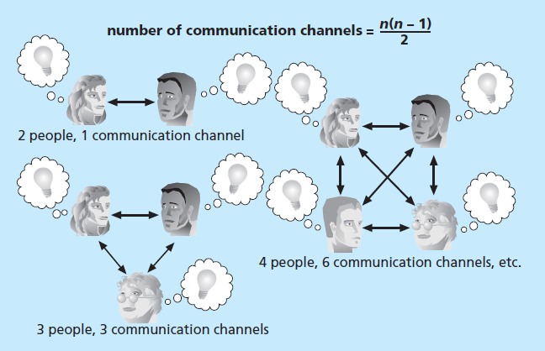
Communication channels
Communication is the oil that keeps everything working properly

Slide 14
Communication Model
Basic Communication Model
The components in the model need to be taken into account when discussing project communications.
The sender is responsible for making information clear and complete so that the receiver can receive it correctly, and for confirming that it is properly understood.
Sender
Noise
Sender
Encode
Encode
Medium
Decode
Decode
Noise
To make effective communication, sender/receiver need to be aware of these factors:
Nonverbal: 55% of all communication is nonverbal
Paralingual: pitch and tone of voice
Effective listening

Slide 15
Communication Methods
Interactive Communication
Most efficient way to ensure a common understanding
E.g. meetings, phone calls, video conferencing
Push Communication
Does not certify that it reached or understood
E.g. letters, email, press release, faxes, voice mail
Pull communication
Used for very large information volumes, very large audiences
E.g. intranet site, e-learning
Project manager cannot control all communications but should try to control to prevent miscommunication, unclear directions, and scope creeps.

Slide 16
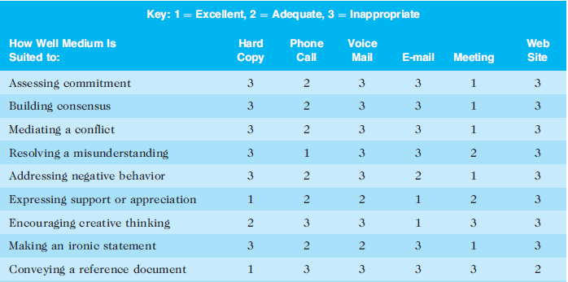
Communication media choice

Slide 17
Communication media choice
Source: Tess Galati, Email Composition and Communication (EmC2), Practical Communications, Inc.,
www.praccom.com (2001)

Slide 18
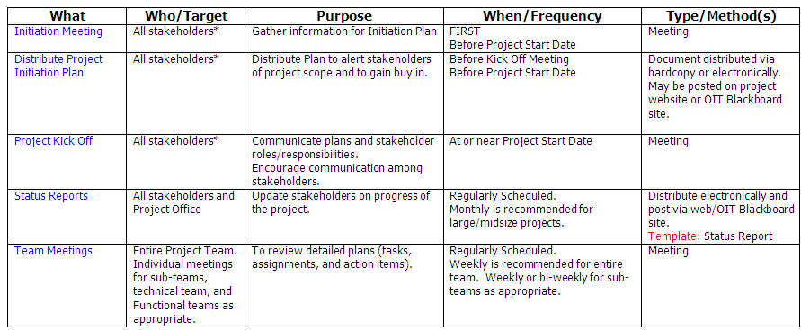
Communication Management Plan
Sample
Sample taken from PRINCETON PROJECT METHODOLOGY - PROJECT COMMUNICATION PLAN (rev. 10/03/03)

Slide 19
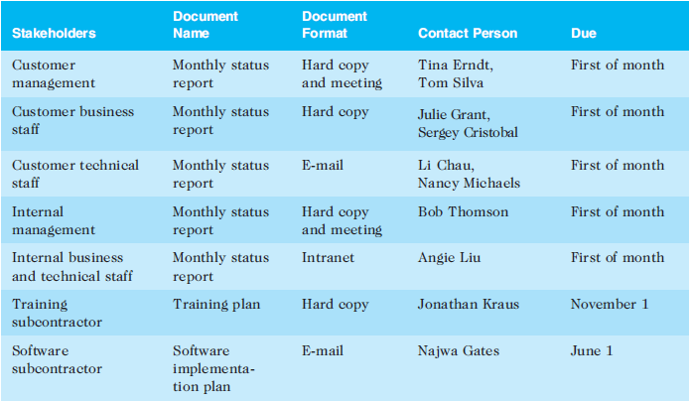
Communication Management Plan
Sample
Standardize communication format!
Sample taken from PRINCETON PROJECT METHODOLOGY - PROJECT COMMUNICATION PLAN (rev. 10/03/03)

Slide 20
How about virtual teams?
They must use e-mail, Web conferencing, instant messaging, discussion threads, project Web sites, and other technologies to communicate most information
they must rely on good written communications

Slide 21
10.4 Manage Communication
creating, distributing, storing, retrieving, and disposing of project communications based on the communications management plan.
Inputs
Communication management plan Work performance reports Enterprise environmental factors Organizational process assets
Tools & Techniques
Communication technology Communication methods Communication models Informations management systems Performance reporting
Outputs
Organizational process assets updates Project communication Project management plan updates Project document updates

Slide 22
Performance Reporting
Status reports
Describe where the project stands at a specific point in time.
Recall the importance of the triple constraint.
Status reports can take various formats depending on the stakeholders’ needs.
Progress reports
describe what the project team has accomplished during a certain period. E.g a monthly progress report

Slide 23
Managing Stakeholder Expectations
Actively managing the expectation of stakeholders.
Increase the likelihood of project acceptance by negotiating.
Influencing their desire to achieve & maintain project goals.
Addressing concerns that have not become issues yet (anticipation).
Clarifying and resolving issues that have been identified.

Slide 24
Controlling Communication
involves monitoring and controlling project communications to ensure that stakeholder communication needs are met.
Inputs
Project management plan Project Communications Issue log Work performance data Organizational process assets
Tools & Techniques
Information management systems Expert judgment meetings
Outputs
Work Performance Information Organizational process updates Change requests Project management plan updates Project document updates
to ensure the optimal flow of information
throughout the entire project life cycle
Report must be truthful and not hide what is really going on.

Slide 25
BaCKUP SLIDES

Slide 26
Exercise
Table taken from PMP Exam Prep 6th Edition, Rita Mulcahy.
Situation | Communication Type
Updating the project plan
Presentations to management
Trying to solve a complex problem
Making notes regarding a telephone conversation
Making changes to a contact
Informing a team member of poor performance (first notice)
Informing a team member of poor performance (second notice)
Scheduling a meeting
Clarifying a work package
Requesting additional resources
Trying to discover the root cause of a problem
Sending an email to ask for clarification of an issue
Holding a milestone party
Conducting a bidder conference
Formal Written
Formal Verbal
Formal Written
Informal Written
Formal Written
Informal Verbal
Formal Written
Informal Written
Formal Written
Informal Verbal
Informal Verbal
Informal Written
Informal Verbal
Formal Verbal

Slide 27
PM Skills
Interpersonal skills
Management skills
Presentation skills
Negotiation
Writing skill
Public speaking
Etc.
Leadership
Team building
Motivation
Communication
Influencing
Decision making
Political & cultural awareness
Negotiation
Etc.

Slide 28
Effective Meeting
Plan or prepare the meeting
Set a time/schedule and determine the participants.
Have a clear purpose for each meeting & communicate it in the invitation.
Create the agenda and distribute it in advance.
Stick to the plan (discipline)
Begin on time, end on time.
Introduce the moderator and stipulate who will keep the minutes.
End every agenda with a summary and consensus of the participants.
Good follow-up
Send the minutes showing the result along with the to do list.
Get feedback from the participants.
Monitor the status of all action items.

