Slide 1
Project Cost Management
Schwalbe (2013), PMBOK 5 ed (2013)
Nicholas & Styen (2012)

Slide 2
Project Cost Management
Monitoring &
Controlling Processes
Planning
Processes
Enter phase/
Start project
Initiating
Processes
Closing
Processes
Exit phase/
End project
Executing
Processes
Knowledge Area | Process
 | Initiating | Planning | Executing | Monitoring & Control | Closing
Cost |  | Plan Cost Cost Estimating Cost Budgeting |  | Cost Control

Slide 3
Introduction
Cost estimates, budgets, WBSs, and schedules are interrelated.
Ideally, cost estimates are based upon elements of the WBS and are prepared at the work package level.
When the cost cannot be estimated because it is too complex, the task is broken down further until it can.

Slide 4
Introduction
Cost estimating, budgeting, and control are sometimes thought to be the exclusive concerns of cost specialists, planners and accountants, but in projects
they should be the concern of everyone.
A 2011 study published in the Harvard Business Review examined IT change initiatives in almost 1,500 projects and reported an average cost overrun of 27 percent!

Slide 5
the United Kingdom’s National Health Service (NHS) IT modernization program
provide an electronic patient records system, appointment booking, and a prescription drug system in England and Wales
the program will eventually cost more than $55 billion, a $26 billion overrun
incompatible systems, resistance from physicians who say they were not adequately consulted about system features,
and arguments among contractors about who’s responsible

Slide 6
Project Cost Management
The process involved in estimating, budgeting, and controlling cost so that the project can be completed within approved budget
Life cycle costing
Looking at the cost of whole life of the product (include maintenance)
Value analysis (value engineering)
Looking at less costly way to do the same work within the same scope
Law of Diminishing Returns
E.g. adding twice resource to task may not get the task done in half cost/time
Time value of money (depreciation)
Cost will also affect the schedule
Cost risk vs. Type of contract

Slide 7
Plan Cost Management
Planning how the costs will be managed throughout the life of the project.
Inputs
Project Management Plan Project Charter Enterprise environmental factors Organizational process assets
Tools & Techniques
Expert judgment Anallytical techniques meetings
Outputs
Cost management plan
Analytical tehcniques: self-funding, funding with equity, or funding with debt.

Slide 8
Cost management plan
Level of accuracy: rounding guidelines, contingency 10-20%
Units of measure: Each unit used in cost measurements, such as labor hours or days, should be defined.
Organizational procedures links: refer to the work breakdown structure (WBS)
Control thresholds: cost variation, ±10 still acceptable
Rules of performance measurement: uses earned value management (EVM)
Reporting formats
Process descriptions

Slide 9
Estimate Cost
The process of developing approximation of the monetary resources needed to complete project activities
Cost trade-offs & risk must be considered
Cost estimates should be refined
Inputs
Cost Management plan Scope baseline Project schedule Human resource plan Risk register Enterprise environmental factors Organizational process assets
Outputs
Activity cost estimates Basis of estimates Project document updates
Tools & Techniques
Expert judgment Analogous estimating Parametric estimating Bottom-up estimating Three-point estimates Reserve analysis Cost of quality Project management estimating software Vendor bid analysis Group decision-making techniques

Slide 10
Types of Cost
Variable Costs
Change with the amount of production/work
e.g. material, supplies, wages
Fixed Costs
Do not change as production change
e.g. set-up, rental
Direct Costs
Directly attributable to the work of project
e.g. team travel, recognition, team wages
Indirect Costs
overhead or cost incurred for benefit of more than one project
e.g. taxes, fringe benefit, janitorial services

Slide 11
Quality/Accuracy of Cost Estimation
Estimate | Accuracy
Rough Order of Magnitude (ROM) | - 50% +100%
Budget Estimate | -10% +25%
Definitive Estimate | -5% 10%
Most difficult to estimate as very little project info is available, made during initiating process
Project selection decisions.
Very early in the project life cycle, often 3–5 years before project completion
allocate money into an organization’s budget.
Used to finalize the Request for Authorization (RFA), and establish commitment, made during planning phase
Early, 1–2 years out
Used for making many purchasing decisions
Estimate actual cost, during the project and refined
Later in the project, less than 1 year out

Slide 12
Quality/Accuracy of Cost Estimation
“Many IT professionals automatically double estimates for software development because of the history of cost overruns on IT projects”

Slide 13
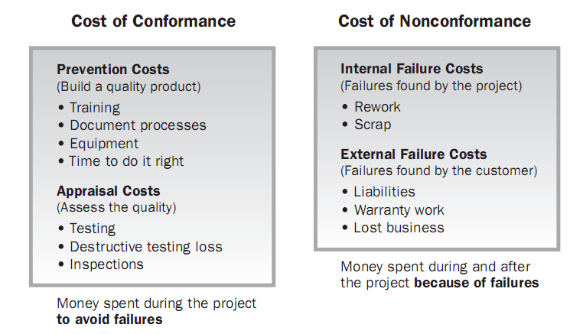
Cost of Quality
Cost of quality (CoQ)
Looking at what the cost of conformance and nonconformance to quality and creating an appropriate balance
.. should be less then..
<
Image Source: PMBOK Guide 4nd Edition. PMI © 2008

Slide 14
Tools and techniques
Analogous Estimating
top-down estimates, use the actual cost of a previous,
similar project as the basis for estimating the cost of the current project.
Parametric Estimating
Mathematical model to estimate project costs
Bottom-up Estimating
the costs of individual work items or activities and summing them to get a project total.
Activity based costing
Three Point Estimate
Most likely (CM), Optimistic (CO), Pessimistic (CP)
PERT (CE) , Expecting cost, CE = (CO + 4 CM + CP) / 6
Triangular : CE = (CO + CM + CP) / 3

Slide 15
Estimate Cost example:

Slide 17
Problem in estimating cost
Estimates are done too quickly.
Large project→big effort
People lack estimating experience.
Capability, cumulative experience, training
Human beings are biased toward underestimation.
Senior vs junior
Management desires accuracy.
Shorter time→negotiate

Slide 18
Determine Budget
Process of aggregating the estimated cost of individual activities or work packages to establish an authorized cost baseline.
Inputs
Cost Management Plan Basis of estimates Scope baselines Project schedule Risk Register Resource calendars Agreement Organizational process assets
Tools & Techniques
Cost aggregation Reserve analysis Expert judgment Historical relationship Funding limit reconciliation
Outputs
Cost performance baseline Project funding requirements Project document updates

Slide 19
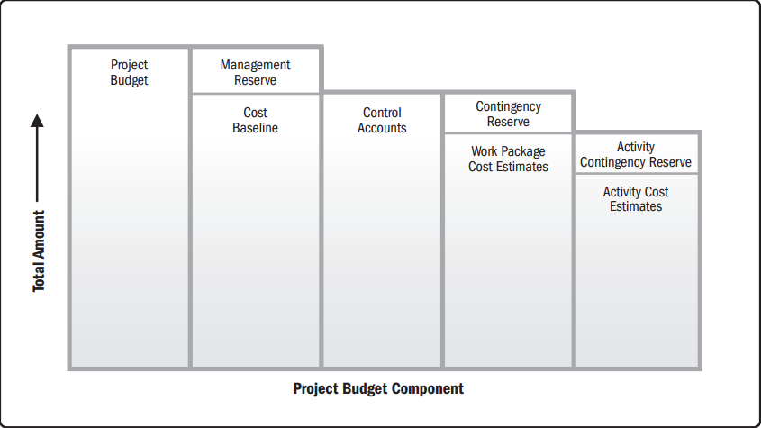
Cost Aggregation
Reserves & risk management are important while estimating!
Contingency reserves: → Cost Baseline the cost impacts of the remaining risk
Management reserves: → Cost Budget extra fund to cover unforeseen risk or changes to the project

Slide 20
Determines Budget: Other considerations
High level parametric estimate as a rule of thumb
E.g. testing cost 50% of development cost
Funding limit reconciliation = checking cash flow
When the money will be available?
Reconciliation needed before proposed cost baseline and cost budget become final
Such reconciliation is part of integration management

Slide 21
Cost aggregation example:

Slide 22
Snapshot
The Obama campaign used 16 different online social platforms,
Sources said that 80 percent of all contributions originated from these social networks,
90 percent of all contributions (which totaled over $600 million) were less than $100 apiece.

Slide 23
Control Cost
The process of monitoring the status of the project to update the project budget and managing changes to the cost baseline
Inputs
Project management plan Project funding requirement Work performance data Organizational process assets
Tools & Techniques
Earned value management Forecasting To-complete performance index Performance reviews Project management software Reserve analysis
Outputs
Work performance measurement Cost forecast Organizational process updates Change requests Project management plan updates Project document updates

Slide 24
How to control cost?
Follow the cost management plan
Look at any organizational process asset that are available
Manage change
Recording all appropriate change
Preventing incorrect change
Ensuring requested changes are agreed upon
Managing the actual changes when and as they occur
Measure and measure and measure (monitoring)

Slide 25
Progress Report
Progress/performance report (output from communication area)
Where work cannot be measured, estimate could be done by a guess
Percent complete:
50/50 Rule
20/80 Rule
0/100 Rule
Activity is considered X percent complete when it begins and get credit for the last Y percent only when it is complete

Slide 26
Earned Value Management
PMI (2011) The researchers surveyed more than 600 project management practitioners in 61 countries has used EVM
Method to measure project performance against scope, schedule and cost baseline (performance measurement baseline)
Interpretation of basic EVM performance measures
Cost Performance Index (CPI)
Schedule Performance Index (SPI)
Image captured from Practice Standard for Earned Value Management, PMI © 2005

Slide 27
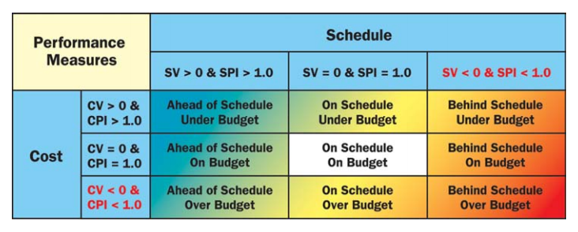
Earned Value Management

Slide 28
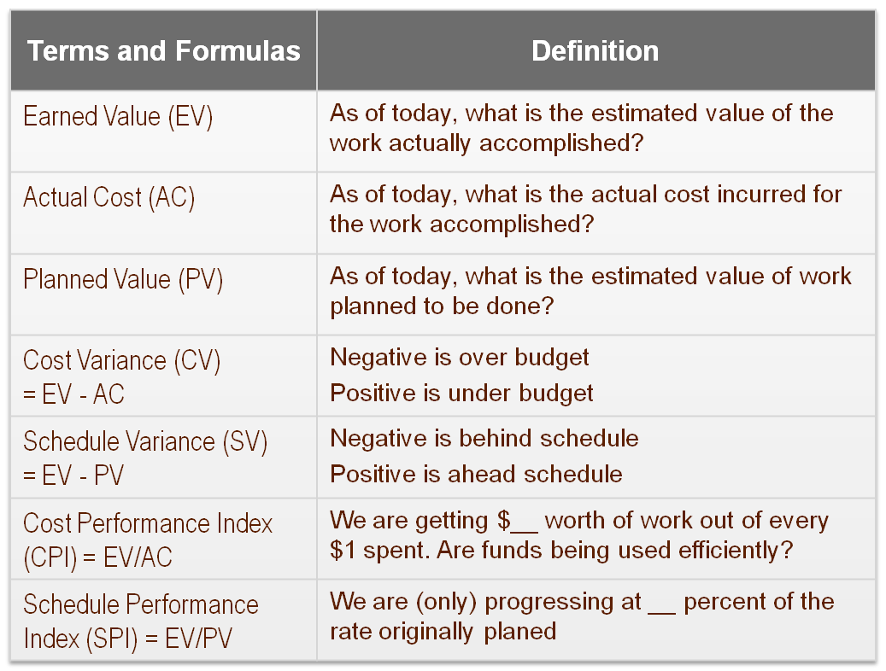
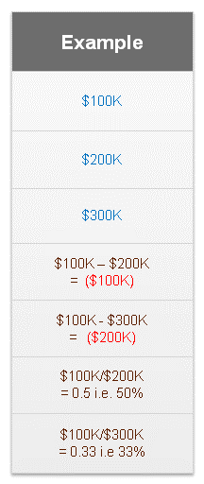
Earned Value Technique
Check point:
At the 3 months
Spent: $200K
Work complete:$100k
Example:
Project Budget: $300K
Project Schedule : 4 months
Revised Total Duration
Baseline Duration/Schedule Performance Index
4/0.33
= 12 months

Slide 29
Earned Value Technique
Terms and Formulas | Definition
Budget at completion (BAC) | How much did we BUDGET for the TOTAL project effort?
Estimate at Completion (EAC) = BAC / CPI | What do we currently expect the TOTAL project cost (a forecast)?
Estimate to Complete (ETC) = EAC - AC | From this point on, how much MORE do we expect it to cost to finish the project (a forecast)?
Variance at Completion (VAC) = BAC – EAC | As of today, how much over or under budget do we expect to be at the end of the project?
EAC is an important forecasting value.

Slide 30
Earned Value: Graphical Representation
TODAY
(Reporting day)
Projection of
schedule delay
at completion
Estimate at Completion
(EAC)
EAC
Projection of
cost variance
at completion
(VAC)
BAC
AC
Budget at Completion
(BAC)
COST
Cost
Variance
(CV)
PV
Schedule
Variance (SV)
ACTUAL
EV
PLAN
EARN
VALUE
TIME
Project is over budget & behind schedule

Slide 31
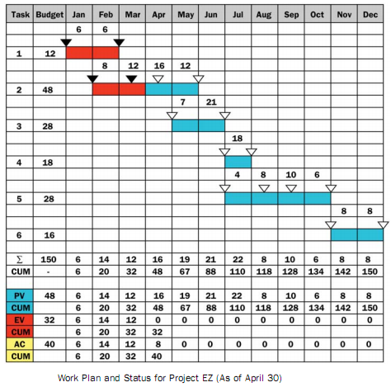
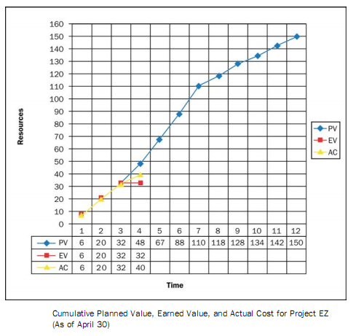
Earned Value Management
EV can be calculated by
(%progress) x (planned man-days)
Image captured from Practice Standard for Earned Value Management, PMI © 2005

Slide 32
Exercise
You have a project to build a box. The box is six sided. Each side is to take one day to build and is budgeted for $1000 per side. The sides are planned to be completed one after the other. Today is the end of day three.
Using the following project status chart, calculate PV, EV, AC, BAC, CV, CPI, SV, SPI, EAC, ETC, VAC.
Describe your interpretation based on the calculation!
Task | Progress | Cost spent
Side 1 | ||||||||||||||||||||||||||||||||||||||||100% | $1,200
Side 2 | ||||||||||||||||||||||||||||||||||||||||100% | $1,000
Side 3 | ||||||||||||||||||||||||||||||75% | $750
Side 4 | ||||||||||||||||||||50% | $500
Side 5 | 0% | $0
Side 6 | 0% | $0

Slide 33
Exercise Solution
Parameter | Calculation | Result
PV
EV
AC
BAC
CV
CPI
SV
SPI
EAC
ETC
VAC
Project is below/over budget?
Project is late/ahead schedule?
How much more money we need?

Slide 34
Exercise Solution
Parameter | Calculation | Result
PV | 1000 + 1000 + 1000 | 3000
EV | (100% x 1000) + (100% x 1000) + (75% x 1000) + (50% x 1000) | 3025
AC | 1200 + 1000 + 750 + 500 | 3450
BAC | 6 x 1000 | 6000
CV | 3025 - 3450 | -425
CPI | 3025 / 3450 | 0.88
SV | 3025 - 3000 | 25
SPI | 3025 / 3000 | 1.01
EAC | 6000 / 0.88 | 6818.18
ETC | 6818.18 - 3450 | 3368.18
VAC | 6000 - 6818.18 | -818.18
over budget, getting 0.88 dollar for every dollar we spent,
ahead schedule, progressing 101% of the rate planned,
probably will spend $6818 at the end (estimation),
need $3368 to complete,
over budget at the end for about $818 (estimation)

Slide 35
Forecasting EAC
There are many ways to calculate EAC, depending on the assumption made.
Simple EAC calculation (EAC = BAC/CPI) assume that the cumulative CPI adequately reflects past performance that will continue to the end of the project.
AC+(BAC-EV)
Used when current variances are thought to be atypical of the future
AC+[(BAC-EV)/(Cumulative CPI + Cumulative SPI)]
It assumes poor cost performance and need to hit a firm completion date.

Slide 36
To-Complete Performance Index (TCPI)
Helps the team determine the efficiency that must be achieved on the remaining work for a project to meet a specified endpoint, such as BAC or the team’s revised EAC
TCPI

Slide 37
BaCKUP SLIDES

Slide 38
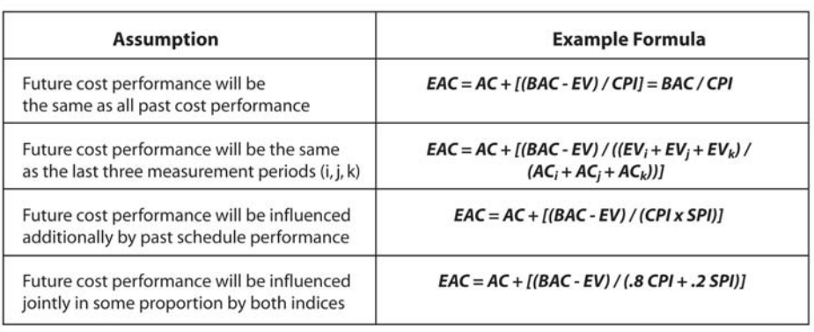
Forecasting EAC
Common alternative way to calculate EAC
Table captured from Practice Standard for Earned Value Management, PMI © 2005

Slide 39
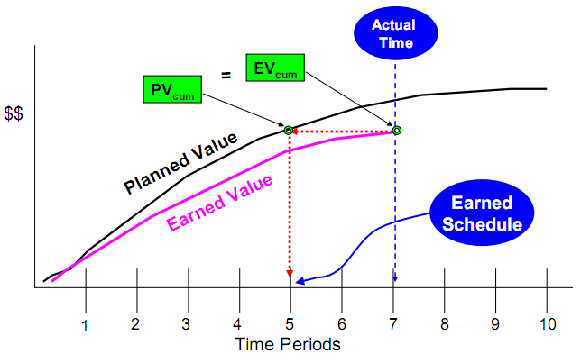
Earned Schedule - An emerging EVM practice
SPI($)
At project start SPI is reliable
At some point SPI accuracy diminishes
Toward the project end it is useless (SPI = 1 at project end)
Doest not show weeks/months of schedule variance
SPI(t)
Time based schedule measures
Create a SPI that is accurate to the of the project
SV(t) = ES – AT
SPI(t) = ES / AT
ES = Earned Schedule (Planned time)
AT = Actual time
See more resources about earned schedule at http://www.earnedschedule.com

Slide 40
EVM – Hints to remember
EV comes first in every formula
If it’s variance, the formula is EV – something
If it’s index, EV / something
If it relates to cost, use Actual Cost
If it relates to schedule, use PV
Negative numbers are bad, positive is good
Copied from Rita’s book

