Slide 1
Project Procurement Management
PMI (2013), Schwalbe (2013)

Slide 2
Indtroduction
Procurement means acquiring goods and services from an outside source.
It can also called outsourcing or purchasing
suppliers, vendors, contractors, subcontractors, or sellers; of these terms, suppliers is the most widely used.

Slide 3
IT Offshoring
U.S. companies are transferring more work abroad, especially in the areas of IT infrastructure, application development and maintenance, and innovation processes.
A shortage of qualified personnel, not cost savings, is the top reason for global outsourcing of IT services.
Atlanta-based Delta Air Lines created 1,000 call-center jobs in India in 2003, saving $25 million→ cost saving 70-90%

Slide 4
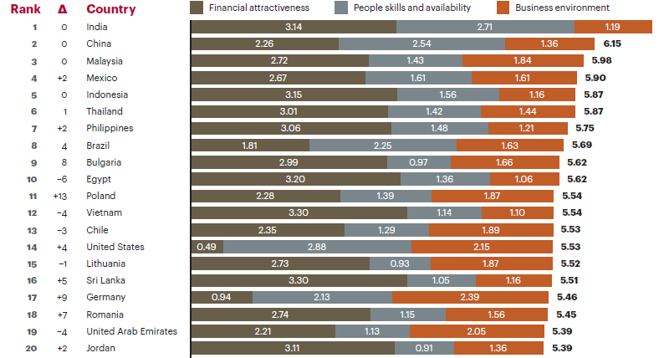
IT offshoring
1. India
2. China
5. Indonesia
Kearney, 2014

Slide 5
introduction
The success of many IT projects that use outside resources is often due to good project procurement management.
Project procurement management includes the processes required to acquire goods and services for a project from outside the performing organization.

Slide 6
Project Procurement Management
Monitoring &
Controlling Processes
Planning
Processes
Enter phase/
Start project
Initiating
Processes
Closing
Processes
Exit phase/
End project
Executing
Processes
Knowledge Area | Process
 | Initiating | Planning | Executing | Monitoring & Contol | Closing
Procurement |  | Plan Procurement | Conduct Procurement | Control Procurement | Close Procurement

Slide 7
Project Manager’s Role in Procurements
PM must be involved in the creation of contracts
Key roles:
Know the procurement process
Understand contract terms and conditions
Make sure the contract contains all project management requirements such as attendance at meeting, reports, actions and communications deemed necessary
Identify risks and incorporate mitigation and allocation of risks into the contract
Help tailor the contract to the unique needs of the project
Align schedule of the contract and schedule of the project
Involved in contract negotiation
Make sure procurement process done smoothly
Work with contract manager to manage changes to the contract
PM must be assigned before contract signed!

Slide 8
12.1 Plan Procurements
What to outsource, determine the type of contract, and describe the work for potential sellers
Inputs
Project management plan Requirement documentation Risk register Activity resource requirements Project schedule Activity cost estimates Stakeholder register Enterprise environmental factors Organizational process assets
Tools & Techniques
Make-or-buy analysis Expert judgment Market research meetings
Outputs
Procurement management plan Procurement statement of work Make-or-buy decisions Procurement documents Source selection criteria Change requests Project documents updates
what to procure and when and how to do it

Slide 9
Make-or-buy analysis
Determine whether an organization should make or perform particular product or service by themselves or buy/acquire from others.
Evaluate of the benefit and drawback
Often involves financial analysis
Make or buy analysis focus on:
skills and resources
cost
time
How critical is it that we retain detailed control over a certain area?
proprietary information or trade secret
Notes:
Does our organization have the skills and resources to make the product or service?
Can we make the product or service more cheaply than we can buy it?
If time is a very important factor, do we need to buy (or make) the product or service to save time?
How critical is it that we retain detailed control over a certain area?
Is there proprietary information that we don’t what other’s to have access to?
Do we have people available who have significant spare capacity (i.e. the organization has to pay for them to stand idle)?

Slide 10
Make-or-buy analysis
a project requires a piece of equipment that has a purchase price of $12,000 and daily operating costs of $400.
lease the same piece of equipment for $800 per day (operational included)
$800/day=$12.000+$400/day
$400/day= $12.000
Day= 30
< 30 day→ leasing
> 30 day→ purchasing
Notes:
Does our organization have the skills and resources to make the product or service?
Can we make the product or service more cheaply than we can buy it?
If time is a very important factor, do we need to buy (or make) the product or service to save time?
How critical is it that we retain detailed control over a certain area?
Is there proprietary information that we don’t what other’s to have access to?
Do we have people available who have significant spare capacity (i.e. the organization has to pay for them to stand idle)?

Slide 11
Contract Types
Fixed-price (FP) contracts
Fixed Price (FP), or Lump Sum, or Firm Fixed Price (FFP)
Fixed Price Incentive Fee (FPIF)
Fixed Price with Economic Price Adjustment (FP-EPA)
Cost-reimbursable (CR) contracts
Cost Plus Fixed Fee Contracts (CPFF).
Cost Plus Incentive Fee Contracts (CPIF).
Cost Plus Award Fee Contracts (CPAF).
Time and Material Contracts (T&M) Hybrid type of contractual arrangement

Slide 12
Fixed-price (FP) contracts
“Any cost overrruns may not be passed to the buyer”
Buyer have experience and know the total price at the project start
Sometime more expensive than cost reimbursable
Seller is most concerned with the SOW
Seller would need huge amount of reserves
Seller can try to increase profit by cutting scope

Slide 13
Fixed-price (FP) contracts
Examples:
FP: Contract = $1M
FPIF: Contract = $1M + for every month added $1000 if performance exceed (risk shared)
FPEA: Contract = $1M + additional pricing based on Government Center Bank depreciation rate/exchange rate or interest rate

Slide 14
Cost Reimbursable (CR) contracts
Risk on buyer!
Used when work is uncertain and, therefore, costs cannot be estimated accurately enough
Requires the seller to have an accounting system that can track costs
Buyer involvelment is very high
Buyer requires auditing seller’s invoice

Slide 15
Cost Reimbursable (CR) contracts
Example:
CPF/CPPC: Contract = cost + fee (10% of cost)
CPFF: Contract = cost + $1K
CPIF: cost + additional fee based on performance
CPAF: cost + additional fee bases on manager satisfaction (performance criteria)

Slide 16
Time & Material (T&M) contracts
Used for service efforts in which the level of effort cannot be defined at the time the contract is awarded
To make sure the costs do not become higher than budgeted, the buyer may put a "Not to Exceed" and time limits clause in the contract.
Often used for staff augmentation, acquisition of experts, outside support
Example:
Contract = $1K per day plus expenses or material cost.
Contract = $1K per day plus material at $5 per linear meter of wood.

Slide 17
Contract Types vs. Risk
Effect of contract type on buyer & seller risk
Low
High
Fixed Price
FFP
FPIF
Time and Materials
Cost Reimbursable
CPIF
CPFF
CPF
CPPC
BUYER
RISK
SELLER RISK
T&M can be a high risk for buyer if contract does not include a “total not-to-exceed” (NTE)
High
Low

Slide 18
Plan Procurement Output
Procurement Management plan
Describe how procurement process will be managed
Guidance for any procurement process
Procurement Statement of Work (SOW)
Develop from scope baseline
Include only the portion will be included within the contract
This can be revised/refined through the procurement process until signed
Make-or-buy decisions
The conclusion reach regarding what product/service/result will be acquired from outside

Slide 19
Procurement Documents (output)
May includes:
Information for Sellers
Contract statement of work
Proposed terms & conditions of the contract
Non-disclosure agreement (NDA) -- to disclose some confidential information
Procurement documents, examples:
Request for Information (RFI)
Invitation For Bid (IFB)
Request For Proposal (RFP)
Request For Quotation (RFQ)
Tender notice
Invitation for negotiation
Invitation for seller’s initial response
Procurement document | Contract Type
RFP | CR
IFB | FP
RFQ | T&M

Slide 20
Procurement Document
Letter of Intent (LOI)
It is not a contract, but a letter without legal binding, that says the buyer intends to hire seller.
Privity of contract
A contractual relationship
Example: You hired a contractor A, and the contractor hires another sub-contractor B to deliver part of your work. Even though B is performing your work, he/she is contractually not bound to you, because B contractually bound to “A” only. So you need to talk to A instead of B.
Teaming Agreements (or a join venture)
Two sellers join force for one procurement

Slide 21
Non competitive Form of Procurement
Form used when only one seller awarded without a competitive procurement.
Should keep follow rules of bidding process and laws
Saving time on procurement process

Slide 22
Non competitive Form of Procurement
Would be implemented in the following condition:
The project under schedule pressure
A seller has unique qualification
There is only one seller
A seller hold a patent
Other mechanism exist that seller’s prices are reasonable.
Type of noncompetitive procurement
Single source: contract directly to preferred seller (historical relationship)
Sole source: there is one seller; might be a company owns a patent

Slide 23
Source selection criteria
Some criteria for evaluating proposals and bids (due diligence):
Understanding of need
Technical Capability
Past performance of sellers (experience)
Project management approach
Financial stability & capacity
Intellectual & property rights
Overall or life cycle cost
Risk
Warranty
References

Slide 24
Important Terms
Price, Profit (fee), Cost
Target price: used to compare the end result of the project with what was expected (the target price).
Sharing ratio: Incentives take the form of a formula, usually expressed as a ratio, e.g. 90/10 (buyer/seller)
Ceiling price: This is the highest price the buyer will pay.

Slide 25
Exercise: Contract Calculation for FPIF
Ceiling price : 120.000
Target cost : 100.000
Target profit: 10.000
Target price: 110.000
Share ratio: 70/30
If actual cost = 90.000, then, total price will be = 90.000+10.000+ (30%*10.000)= 103.000
If actual cost = 105.000, then, total price will be = 105.000+ 10.000= 115.000
If actual cost = 115.000, then, total price will be = 120.000
If actual cost = 125.000, then, total price will be = 120.000

Slide 26
Exercise: Contract Calculation for CPCC
Estimate cost = 100.000
Agree upon precentage = 10%
Estimated total price= 110.000
If the seller increase cost to 110.000 then the total price would be 121.000
The most undesirable type of contract

Slide 27
Exercise: Contract Calculation for CPFF
Estimate cost = 100.000
Agree upon precentage = 10%=10.000
Estimated total price= 110.000
The fee remain = 10.000

Slide 28
Exercise: Contract Calculation for CPIF
Expected cost = 100.000
Fee to seller= 10.000
Sharing formula = 85/15
The final cost (actual cost) = 80.000
The seller final reimbursable cost= 80.000+ 10.000+ (15%*20.000)= 93.000

Slide 29
12.2 Conduct Procurements
The process of obtaining seller responses, selecting a seller, and awarding a contract.
Inputs
Procurement management plan Procurement documents Source selection criteria Seller proposals Project documents Make-or-buy decisions Procurement statement of works Organizational process assets
Tools & Techniques
Bidder conferences Proposal evaluation techniques Independent estimates Expert judgment Advertising Analytical technique Procurement negotiations
Outputs
Selected sellers agreement Resource calendars Change requests Project management plan updates Project document updates

Slide 30
Proposal Evaluation (Tools & Techniques)
Proposal Evaluation or Bid or Price Quote
One or a combination of following process used for selecting seller:
Weighting system Evaluate by weighting the source selection criteria
Independent estimate Estimation created in-house or with outside assistance
Screening system Eliminate sellers who do no meet minimum requirement
Past performance history

Slide 31
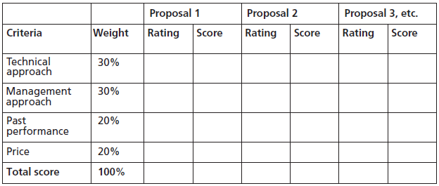
Proposal Evaluation (Tools & Techniques)

Slide 32
Procurement Negotiations (Tools & Techniques)
Objective of negotiation:
Obtain fair and reasonable price
Develop good relationship with the seller
Main items to negotiate:
Scope
Schedule
Price & payment
Responsibilities
Authority
Applicable law
Technical & business management approaches
Contract financing

Slide 33
Contract Document
Agreement, subcontract, purchase order, memorandum of understanding (MOU)
A legal contract will need..
An offer
Acceptance
Consideration (Something of value, not necessary money)
Legal capacity (Separate legal parties, competent parties)
Legal purpose (We cannot have a contract for something illegal)
Purpose of contract:
To define role and responsibilities
To make things legally binding
To mitigate or allocate risks.

Slide 34
Contract Document
Statement of work or deliverables
Schedule baseline
Performance reporting
Period of performance
Role & responsibilities
Seller’s place of performance
Pricing
Payment terms
Place of delivery
Inspection and acceptance criteria
Warranty

Slide 35
12.3 Control Procurements
The process of managing procurement relationship, monitoring contract performance and making change and corrections as needed.
Inputs
Procurement documents Project management Plan Agreements Approved change request Work Performance data Work Performance data
Tools & Techniques
Contract change control system Procurement performance reviews Inspections and audits Performance reporting Payment system Claims administration Records management system
Outputs
Work Performance information Project Management plan update Organizational process assets updates Change request Project documents updates

Slide 36
12.4 Close Procurements
The process of completing each project procurement.
Inputs
Project Management Plan Procurement documentation
Tools & Techniques
Procurement audits Procurement Negotiated Records management system
Outputs
Closed procurements Organizational process assets updates

Slide 37
Negotiated Settlements
Whenever settlement cannot be achieved by direct negotiation , some form of alternative dispute resolution (ADR) including mediation or arbitration may be explored .
When all else fails , litigation in the courts is the least desirable option
negotiate
ADR
Court

