Slide 1
Project Quality Management
PMBOK 5 ed, Schwalbe (2013)

Slide 2
Introduction
In one of the biggest software errors in banking history, Chemical Bank mistakenly deducted about $15 million from more than 100,000 customer accounts.
“The problem resulted from a single line of code in an updated computer program that caused the bank to process every withdrawal and transfer at its automated teller machines (ATMs) twice.
For example, a person who withdrew $100 from an ATM had $200 deducted from his or her account, though the receipt indicated only a withdrawal of $100.
The mistake affected 150,000 transactions”

Slide 3
Introduction
Toyota Motor Sales U.S.A. is recalling approximately 247,000 cars because of potentially defective front passenger airbag inflators supplied by Takata Corp.
The recall includes the 2002-'05 Lexus SC and Toyota Sequoia, and the 2003-'05 Toyota Tundra, Corolla and Corolla Matrix.
More than 4.5 million cars are affected by the Takata recall
Toyota has reached a record $1.32 billion settlement to resolve a criminal investigation into safety issues that have been linked to at least five deaths.

Slide 4
8. Project Quality Management
Monitoring &
Controlling Processes
Planning
Processes
Enter phase/
Start project
Initiating
Processes
Closing
Processes
Exit phase/
End project
Executing
Processes
Knowledge Area | Process
 | Initiating | Planning | Executing | Monitoring & Contol | Closing
Cost |  | Quality Planning | Perform Quality - Assurance | Perform Quality - Control

Slide 5
Project Quality Management
Quality is degree to which the project fulfills requirements
Quality Management includes creating and following policies and procedures to ensure that a project meet the defined needs (from the customer’s perspective).
“Completing project with no deviations from the project requirements”

Slide 6
Quality Concepts
Quality vs. Grade
Quality: the degree to which a set of inherent characteristics fulfill requirements
Quality level that fails to meet quality requirements is always a PROBLEM
Grade: a category assigned to product or service having the same functional use but different technical characteristics
Low grade may not be a problem

Slide 7
Quality Management: Important points
Customer satisfaction
Conformance to requirement
Fitness for use: product/service produced must satisfy real needs
Prevention over inspection
Cost of preventing mistakes < cost of correcting
Continuous improvement (Kaizen)
Based on PDCA cycle→ PLAN,DO,CHECK, ACTION
Using quality improvement initiatives e.g. TQM, 6 sigma
Using process improvement models e.g. OPM3, CMMI, Malcolm Baldrige
Management responsibility
To provide the resource needed to succeed

Slide 8
Quality Concepts
Gold Plating: giving the customer extras
This practice is not recommended
Marginal Analysis: looking for the point where.. “benefits/revenue to be received from improving quality EQUALS the incremental cost to achieve that quality”
.

Slide 9
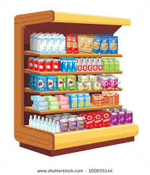
Quality Concept
Just in Time (JIT): just when they are needed or just before they are needed.
It forces attention on quality practices.
Supermarket concept→
Total Quality Management (TQM)
Company & their employees focus on finding ways to continuous improve the quality of their business practices & products

Slide 10
8.1 Plan Quality
The process of identifying requirement and/or standards for the project and product and documenting how the project will demonstrate compliance.
What is quality? How will we ensure it?
Inputs
Project Management Plan Stakeholder register Requirements Documentation Risk register Enterprise environmental factors Organizational process assets
Tools & Techniques
Cost benefit analysis Cost of Quality (CoQ) Seven Basic Quality tools Benchmarking Design of experiments Statistical sampling Additional quality planning tools meetings
Outputs
Quality management plan Quality metrics Quality checklists Process improvement plan Project document updates
“Set a standar”

Slide 11
Quality Planning Techniques
Cost benefit analysis
Weight the benefits versus the cost of meeting quality requirements
Design of Experiments (DOE)
Use experimentation to statistically determine what variable will improve quality
Systematically changing all of the important factors, rather than changing the factors one at a time
Statistical sampling
We need it since studying entire population would take too long, too much cost, be too destructive
Flow charting
Use to see a process or system flows and find potential quality problem

Slide 12
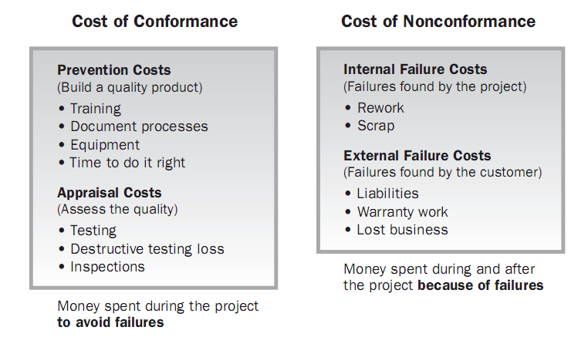
Cost of Quality
Cost of quality (CoQ)
Looking at what the cost of conformance and nonconformance to quality and creating an appropriate balance
.. should be less then..
<
Image Source: PMBOK Guide 4nd Edition. PMI © 2008

Slide 13
Cost of Quality
Cost of Conformance | Cost of Nonconformance
Quality training | Rework/Repair
Quality audit | Scrap
Studies, Surveys | Inventory cost
Effort to ensure everyone knows the process to use to complete their work | Warranty cost
Quality staff | Lost business

Slide 14
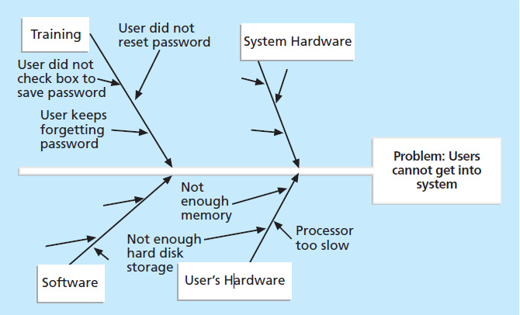
Seven quality tools
Ihikawa/Fishbone chart/ cause effect diagram/ 5 whys,

Slide 15
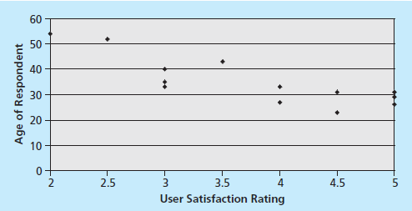
Seven quality tools
Checksheet → collect and analyze data.
Scatter diagram/Regression Analyis→
if there is a relationship between two variables, diagonal line

Slide 16
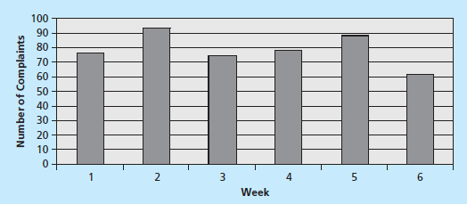
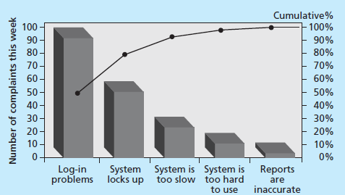
Seven quality tools
Histogram→ a bar graph of a distribution of variables.
Pareto→ a histogram that can help you identify and prioritize
problem areas. 80/20
referred to as the 80-20 rule
meaning that 80 percent
of problems are often due to 20 percent of the causes.
Notes:
Logi 55%

Slide 17
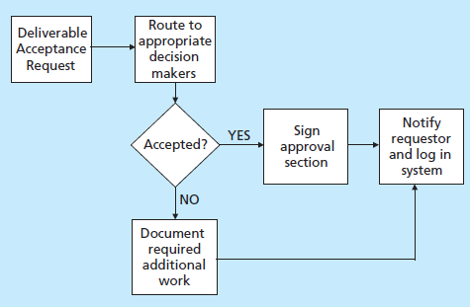
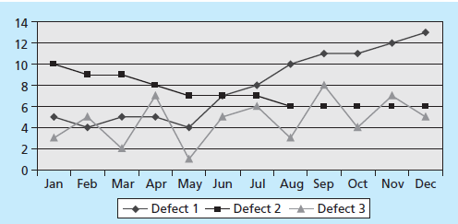
Seven quality tools
Flowcharting→ analyze how problems occur and how processes can be improved.
Run Chart: To look at history and see a pattern of variation

Slide 18
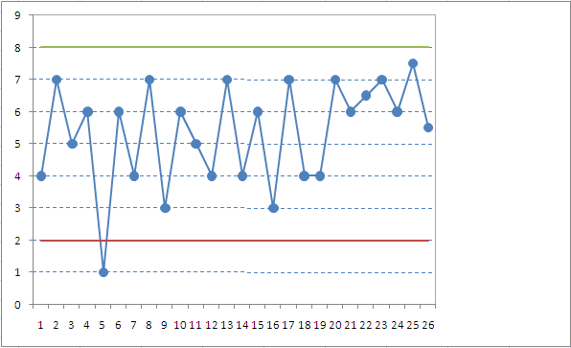
Control Charts
Rule of seven (non random data points)
Out of control
Assignable/special cause
Normal and expected variation
Usually 3 or 6 sigma
Upper control limit
Lower control limit
Normal distribution curve
Out of control
Assignable/special cause
Specification limit: is point determines by customer, not calculated based on control chart

Slide 19
Additional Quality Planning tools
Six Sigma’s target for perfection→ the achievement of no more than 3.4 defects, errors, or mistakes per million opportunities.
Define, Measure, Analyze, Improve, and Control
Another modern quality management:
Deming, Juran, Crosby, Ishikawa, Taguchi, and Feigenbaum, MBNQA, ISO, CMMI

Slide 20
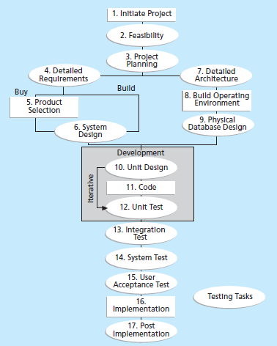
Testing tasks in the software development life cycle

Slide 21
Output
Quality Management Plan
Contains:
Project management method
Role and responsibility in managing quality
Deliverable measurement
Standard for monitoring & control purpose
Process review
Major check points
Inspection & acceptance criteria
Quality metrics is input for
Quality Assurance AND
Quality Control
Quality checklist is input for
Quality Control ONLY

Slide 22
output
Quality metrics
An operational that describes how quality control process will measure it.
What are things that important to measure and decide what measurement is acceptable
Examples: failure rates of products, availability of goods and services, and customer satisfaction ratings.
Quality checklists
A list of items to inspect, step to be performed and note if any defects found

Slide 23
Important scope aspects of IT projects that affect quality include
functionality and features: the degree to which a system performs its intended function.
system outputs: define clearly what the screens and reports look like for a system.
Performance : how well a product or service performs the customer’s intended use.
Reliability: the ability of a product or service to perform as expected under normal conditions.
Maintainability: the ease of performing maintenance on a product.

Slide 24
8.2 Perform Quality Assurance
The process of auditing the quality requirement and the result of quality control measurements to ensure appropriate quality standards and operational definitions are used.
Inputs
Quality Management plan Process improvement plan Quality metrics Quality control measurement Project Documents
Tools & Techniques
Plan quality and Perform Quality Control tools & techniques Quality audits Process analysis
Outputs
Organizational process updates Change requests Project management plan updates Project document updates

Slide 25
Quality Assurance
Are we using the standard?
Can we improve the standard?
Quality Audits
To see if you are complying with company policies, standards & procedures
Determine whether they are used efficiently & effectively
Identify all the good practices being implemented
Identify all the gaps/shortcomings
Look for new lesson learned & good practices
Process Analysis
Includes root cause analysis

Slide 26
8.3 Perform Quality Control
The process of monitoring and recording results of executing the quality activities to assess performance and recommend necessary changes.
Inputs
Project management plan Quality metrics Quality checklist Work performance measurements Approved change requests Deliverables Project Documents Organizational process assets
Tools & Techniques
Seven Basic quality tools Statistical sampling Inspection Approved change request s reviews
Outputs
Quality control measurements Validated changes Validated deliverables Works Performance informations Organizational process updates Change requests Project management plan updates Project document updates

Slide 27
BaCKUP SLIDES

Slide 28
Important Terms
Mutual Exclusive: if two events cannot both occur in a single trial
Probability: something will occur
Normal Distribution: common probability density distribution chart
Statistical independence: the probability of one event occurring does not affect the probability of another event occurring
Standard deviation (or Sigma): how far you are from the mean
3 or 6 sigma
Represent the level of quality has decided to try to achieve
6σ is higher quality standard than 3σ
Used to calculate the upper and lower control limits in a control chart
Number of σ | Percentage of occurrences between two control limits
1 | 68.26%
2 | 95.64%
3 | 99.73%
6 | 99.99985%

