Slide 1
Scope Management
PMBOK 5 (2013), Kathy Schwable (2013)

Slide 2
Project Scope Management
Project scope management includes the processes involved in defining and controlling what work is or is not included in a project
ensures that the project team and stakeholders have the same understanding of what products the project will produce and what processes the project team will use to produce them

Slide 3
Project Scope Management
Plan Scope
Management
Define Scope
Validate Scope
Control Scope
Collect
Requirements
Create WBS

Slide 4
Project Scope Management
Monitoring &
Controlling Processes
Planning
Processes
Enter phase/
Start project
Initiating
Processes
Closing
Processes
Exit phase/
End project
Executing
Processes
Knowledge Area | Process
 | Initiating | Planning | Executing | Monitoring & Control | Closing
Scope |  | Plan Scope Collect Requirements Define Scope Create WBS |  | Verify Scope Control Scope

Slide 5
1. Planning scope management
involves determining how the project’s scope and requirements will be managed. The project team works with appropriate stakeholders to create a scope management plan and requirements management plan.
2. Collecting requirements
involves defining and documenting the features and functions of the products for the project as well as the processes used for creating them. The project team creates requirements documentation and a requirements traceability matrix as outputs of the requirements collection process.

Slide 6
3. Defining scope
involves reviewing the scope management plan, project charter, requirements documents, and organizational process assets to create a scope statement
Adding more information as requirements are developed and change requests are approved.
The main outputs of scope definition are the project scope statement and updates to project documents.

Slide 7
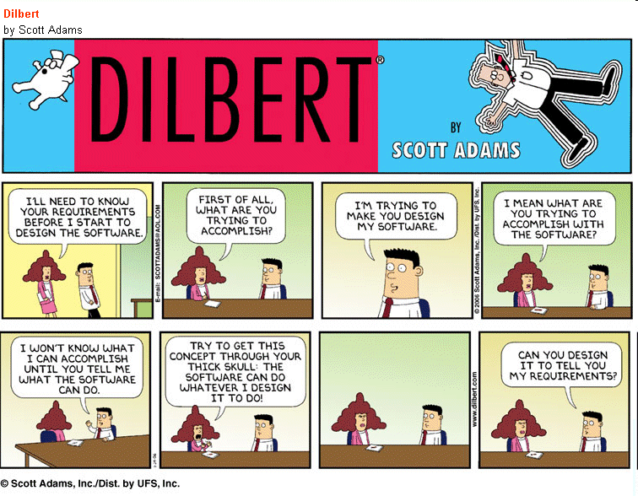

Slide 8
4. Creating the WBS
Involves subdividing the major project deliverables into smaller, more manageable components.
The main outputs include a scope baseline (which includes a work breakdown structure and a WBS dictionary) and updates to project documents.

Slide 9
5. Validating scope
involves formalizing acceptance of the project deliverables.
Key project stakeholders, such as the customer and sponsor for the project, inspect and then formally accept the deliverables during this process.
If the deliverables are not acceptable, the customer or sponsor usually requests changes.
The main outputs of this process, therefore, are accepted deliverables, change requests, work performance information, and updates to project documents.

Slide 10
6. Controlling scope
involves controlling changes to project scope throughout the life of the project—a challenge on many IT projects.
Scope changes often influence the team’s ability to meet project time and cost goals, so project managers must carefully weigh the costs and benefits of scope changes.

Slide 11
Plan Scope
Product scope
Project (process) scope)
Inputs
Project Management Plan Project charter Enterprise Environmental Factor Organizational Process Asset
Tools & Techniques
Expert Judgement Meeting
Outputs
Scope Management Plan Requirements management plan
Supporting facility

Slide 12
Collect Requirement
Inputs
Scope Management Plan Requirements management plan Project charter Stakeholder register
Tools & Techniques
Interviews Focus groups Facilitated workshops Group creativity techniques Group decision making techniques Questionnaires and surveys Observations Prototypes Bench marking Context Diagram Document Analysis
Outputs
Requirements document Requirements management plan Requirements traceability matrix

Slide 13
Collect Requirement Techniques (1)
INTERVIEWS: Directly talk with stakeholders
FOCUS GROUPS: Interactive discussion with qualified Stakeholders & Subject matter experts
FACILITATED WORKSHOPS: Focused cross functional stakeholders.
JAD Joint application design,
QFD Quality function development Helps determine critical characteristic of new product development Start by collecting customer need - VOC: Voice of the Customers

Slide 14
Collect Requirement Techniques (2)
GROUP CREATIVITY TECHNIQUES:
Brainstorming,
Nominal group technique: enhance brainstorming with voting and ranking
Delphi Technique: some expert answer questionnaire and give anonimity feedback
Idea/mind mapping,
Affinity Diagram: sort idea into groups
GROUP DECISION MAKING TECHNIQUES:
Unanimity,
Majority (>50%),
Plurality,
Dictatorship

Slide 15
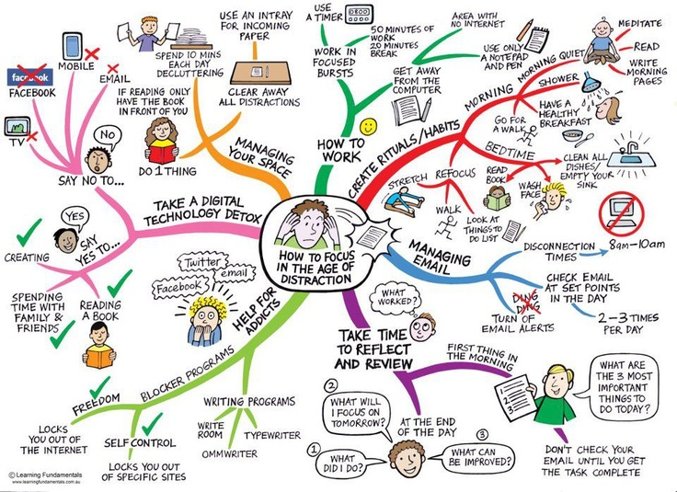

Slide 16
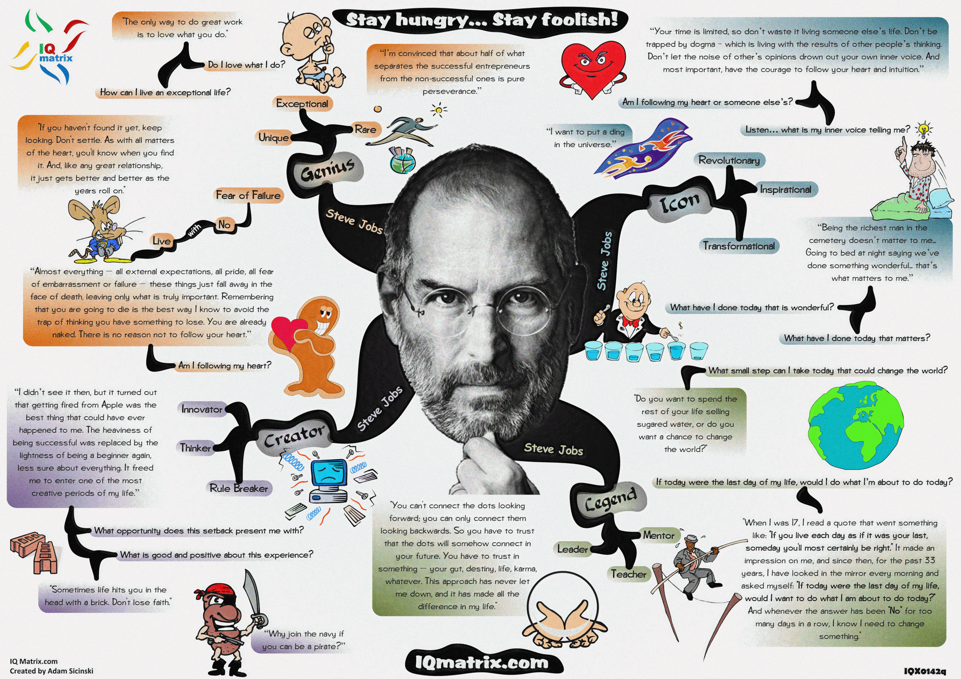

Slide 17
Factor Rating
Criteria | Weight | Cibiru | score | antapani | score | ciganitri | score
Demand | 25% | 7 | 1,75 | 9 | 2,25 | 7 | 1,75
Technology supported | 15% | 6 | 0,9 | 8 | 1,2 | 6 | 0,9
Competitor | 10% | 8 | 0,8 | 9 | 0,9 | 8 | 0,8
Community acceptance | 15% | 9 | 1,35 | 7 | 1,05 | 9 | 1,35
Governance acceptance | 15% | 9 | 1,35 | 7 | 1,05 | 8 | 1,2
Market expansion | 20% | 6 | 1,2 | 8 | 1,6 | 9 | 1,8
total | 100% |  | 7,35 |  | 8,05 |  | 7,8

Slide 18
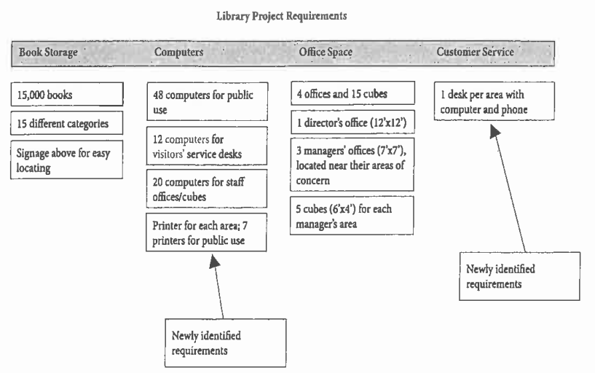
Affinity Diagram
Requirement sorted into groups by similarities
Easier to see additional scope (risk) that have not been identified
Image Source: PMP Exam Preparation 6th Edition, Rita Mulcahy

Slide 19
Collect Requirement Techniques (3)
QUESTIONNAIRE AND SURVEYS: wide number of respondents
OBSERVATION/JOB SHADOWING: viewing individual in their environment
PROTOTYPES: early feedback by providing a working model

Slide 20
Balance Stakeholder’s Requirement
There is a need to balance stakeholder’s requirement
Some issue are so complex they cannot be resolved by PM alone
Facilitate the resolution of competing requirement, consider:
business case,
project charter,
project scope statement,
project constraints
What you can do:
Conflict resolution, team building, meeting, problem solving skills, escalation, approval from stakeholder
Stakeholder request to do or add something that is not related to the reason of project created should be rejected!

Slide 21
Requirement Document
Output of the Collect Requirement process
Helps make sure the requirements clear and unambiguous.
How will we know if the work we do will acceptability meet this requirement?
Rule of thumb
Specific (Unambiguous)
Measurable (How will we know we have finished?)
Achievable (Can we do it?)
Relevant (Is it the right thing to do?)
Timed (When will we do it?)

Slide 22
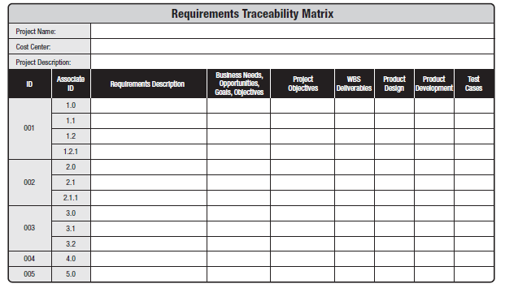

Slide 23
Table 5-1. Sample Requirements Traceability Matrix

Slide 24
Define Scope
Product desc
Project accpetance criteria
Project cosntraints
Risk
Deliverable etc
Inputs
Scope Management Plan Project charter Requirements documentation Organizational process assets
Tools & Techniques
Expert judgment Product analysis Alternatives Identification Facilitated workshops
Outputs
Project scope statement Project document updates
Memo
List register
note

Slide 25
National car project 4 seater?
Seven seater? SUV? Safety? Air bag? city car?
Public transportation?
Gas? Electric?
Subsidize?
Survey
Benchmarking
workshop

Slide 26
Define Scope
Concern with what is and is not included in the project and its deliverables
You should maintain a realistic schedule and budget that can achieve the project’s scope
Iteration process should be done to maintain it
Looking for options to adjust the project
Analyze the objective and description of the product stated by the customer/sponsor and turn them into tangible deliverables.
Project lifecycle term
Product Analysis

Slide 27
Project Scope Statement
The primary result of the Define Scope process
Along with the WBS and WBS dictionary, comprise the scope baseline is part of project management plan.
May includes:
Product scope
Deliverables
Product acceptance criteria
What is not part of the project (out of scope)
Additional risks
Constraints and assumptions : Constraints: factors that limit the team’s options Assumptions: Things that assumed to be true (may not be true)

Slide 28
Create WBS
Inputs
Scope Management Plan Project scope statement Requirements documentation Organizational process assets
Tools & Techniques
Decomposition
Outputs
Scope baseline Project document update
WBS does not show dependencies
Dividing work package into activities is part of the time management process (Define Activities)

Slide 29
Create WBS
WBS includes the project management works.
Work package: lowest level WBS component which can be scheduled, cost estimated, monitored and controlled.
WBS Structure can be organized by
Phases
Major deliverables
Subprojects e.g. contracted work
Beware of excessive decomposition. It can lead to non-productive management effort, inefficient use of resources (performing work)
TIMWOOD (Transportation, Inventory, Motion, Waiting, Over-processing, Over-production, Defect (Toyota Way)

Slide 30
Create WBS
Control account: management control point for performance measurement (one or more work packages)
WBS dictionary provides more detailed components, e.g. description of work, responsible organization, acceptance criteria
Agreed Scope baseline includes project scope statement, WBS, WBS dictionary

Slide 31
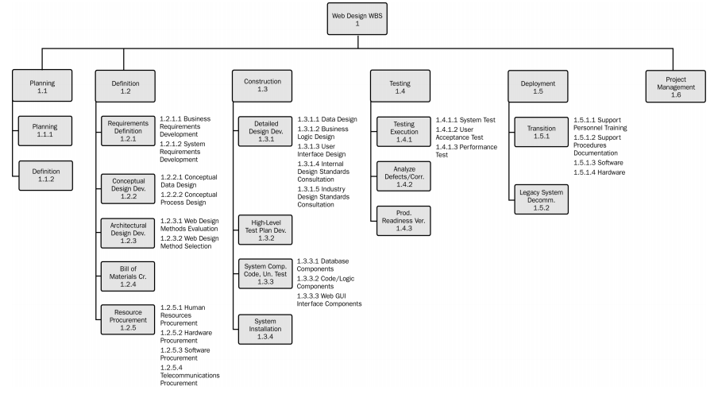
WBS Sample
Image Source: Practice Standard for WBS 2nd Edition. PMI © 2006

Slide 32
WBS
100% rule: WBS includes 100% of the work defined by project scope and capture ALL deliverables (external, internal, interim) in term of work to be completed including project management.
WBS creation method:
Top-Down
Bottom up
WBS Standard
WBS Templates
Don’t mind with WBS view
Outline View
Tabular View
Tree structure view (vertical, horizontal, centralized)

Slide 33
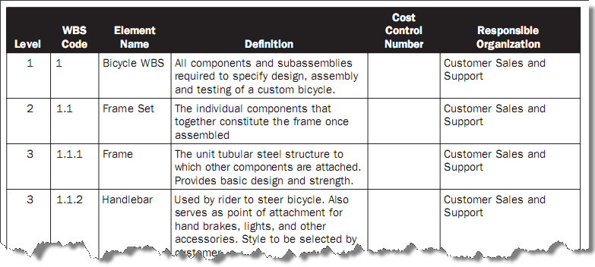
WBS Dictionary Sample
Includes (but not limited to):
Code of account identifier
Description of work
Responsible organization
List of schedule milestone
Associated schedule activities
Resource required
Cost estimates
Quality requirements
Acceptance criteria
Technical references
Contract Information
Image Source: Practice Standard for WBS 2nd Edition. PMI © 2006

Slide 34
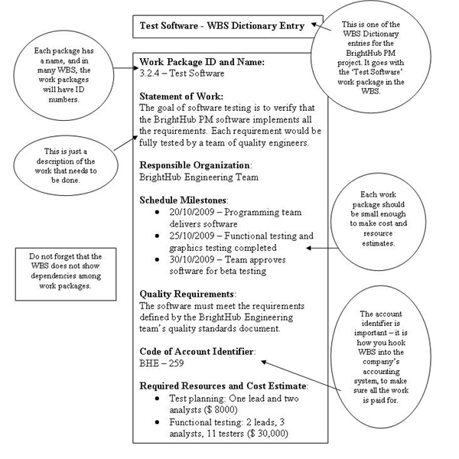
WBS Dictionary Sample (2)
Source: http://www.brighthub.com/office/project-management/articles/52388.aspx

Slide 35
WBS Dictionary..

Slide 36
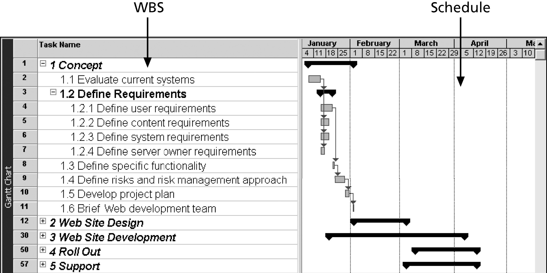
Figure 5-5. Intranet WBS and Gantt Chart in Microsoft Project

Slide 37
Validate Scope
Inputs
Project management plan Requirements documentation Requirement traceability matrix Verified deliverables Work performance data
Tools & Techniques
Inspection Group decision-making techniques
Outputs
Accepted deliverables Change requests Work performance information Project document updates

Slide 38
Validate Scope
Different with quality control which concerned with correctness of deliverables.
Can be performed before or parallel
NOT making sure you have the right scope during project planning
But, to gain formal acceptance of deliverables during monitoring and control.
Inspection = review, product reviews, audits, walkthroughs
Measuring, examining, verifying to determine work and deliverables are meet requirement & product acceptance criteria

Slide 39
Control Scope
Inputs
Project management plan Work performance information Requirements document Requirement traceability matrix Organizational process assets
Tools & Techniques
Variance analysis
Outputs
Work performance measurements Organizational process assets updates Change requests Project management plan updates Project document updates

Slide 40
Scope Baseline
Project Scope Statement
WBS
WBS Dictionary

Slide 41
What Went Wrong?
A project scope that is too broad and grandiose can cause severe problems
Scope creep and an overemphasis on technology for technology’s sake resulted in the bankruptcy of a large pharmaceutical firm, Texas-based FoxMeyer Drug
In 2001, McDonald’s fast-food chain initiated a project to create an intranet that would connect its headquarters with all of its restaurants to provide detailed operational information in real time; after spending $170 million on consultants and initial implementation planning, McDonald’s realized that the project was too much to handle and terminated it

Slide 42
y

Slide 43
Scope Problems
Poor User Input
Scope Creep

Slide 44
Best Practices for Avoiding Scope Problems
Keep the scope realistic. Don’t make projects so large that they can’t be completed. Break large projects down into a series of smaller ones.
2. Involve users in project scope management. Assign key users to the project team and give them ownership of requirements definition and scope verification.

Slide 45
Best Practices for Avoiding Scope Problems
3. Use off-the-shelf hardware and software whenever possible. Many IT people enjoy using the latest and greatest technology, but business needs, not technology trends, must take priority.
4. Follow good project management processes. As described in this chapter and others, there are well-defined processes for managing project scope and others aspects of projects.

