Slide 1
Project Time Management
Schwalbe (2013), PMBOK 5 ed (2013). Nicholas & Styen (2012)

Slide 2
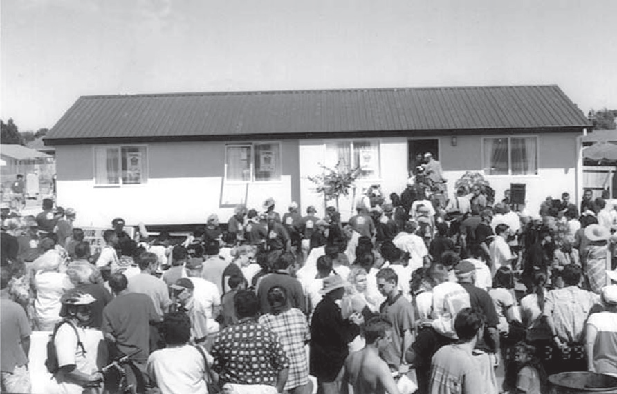
What made the speedy completion possible?
abundant resources:
150 people
14 months of planning, including many iterations of network analysis.
a systematic computerized method
On March 13, 1999, the Manukau (New Zealand) Chapter of Habitat for Humanity (the non-profit organization dedicated to eliminating poverty housing) set the new record for building a house: 3 hours and 45 minutes.

Slide 3
Project Time Management
Monitoring &
Controlling Processes
Planning
Processes
Enter phase/
Start project
Initiating
Processes
Closing
Processes
Exit phase/
End project
Executing
Processes
Knowledge Area | Process
 | Initiating | Planning | Executing | Monitoring & Control | Closing
Time |  | Plan Schedule Activity Definition Activity Sequencing Activity Resource Estimating Activity Duration Estimating Schedule Development |  | Schedule Control

Slide 4
Project Time Management
Every system is constrained by policies, procedures, and standards; available materials, knowledge, and technology; and limited time, funding, and resources.
Managers often cite delivering projects on time as one of their biggest challenges
Time has the least amount of flexibility; it passes no matter what happens on a project
Schedule issues are the main reason for conflicts on projects, especially during the second half of projects

Slide 5
Importance of Project Schedules
The process required to manage timely completion of the project
Project time management start with planning by the project management team (not shown as a discrete process)
In small project, defining & sequencing activities, estimating activity resource & duration, developing schedule are viewed as a single process.

Slide 6
Project Time Process
Planning schedule management involves determining the policies, procedures, and documentation that will be used for activites in project life scyle .
Defining activities involves identifying the specific activities that the project team members and stakeholders must perform to produce the project deliverables e.g expected duration, cost, and resource requirements.

Slide 7
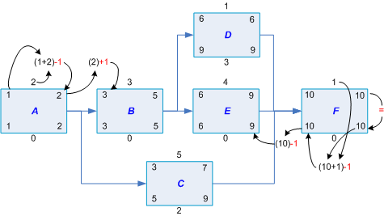
Project Time Process
Sequencing activities involves identifying and documenting the relationships between project activities. The main outputs of this process include project schedule network diagrams and project documents updates.

Slide 8
Estimating activity resources involves estimating how many resources— people, equipment, and materials.
The main outputs of this process are activity resource requirements,a resource breakdown structure, and project documents updates.
Estimating activity durations involves estimating the number of work periods that are needed to complete individual activities. Outputs include activity duration estimates and project documents updates.

Slide 9
Developing the schedule involves analyzing activity sequences, activity resource estimates, and activity duration estimates .
Controlling the schedule involves controlling and managing changes to the project schedule.

Slide 10
Plan Schedule
Contingency
Unit of measure (km, kg, etc)
Accuracy range
Performance measure
Inputs
Project Management plan Project Charter Enterprise environmental factors Organizational process assets
Tools & Techniques
Expert judgment Analytical technique Meetings
Outputs
Schedule management plan

Slide 11
Define Activities
Work package decomposed into activities (schedule activities)
Inputs
Schedule management plan Scope baseline Enterprise environmental factors Organizational process assets
Tools & Techniques
Decompositions Rolling wave planning Expert judgment
Outputs
Activity list Activity attributes Milestone list
In the real word sometime we skip define activities since we take WBS down to the activity level. This is not a wrong practice but not a PMBOK practice.

Slide 12
Define Activities (Tools & Techniques)
Rolling Wave Planning: progressive elaboration planning where you do not to plan activities until you start the project management process for that phase is in the project life cycle
Activity Attributes:
Use for schedule development, selecting, ordering, sorting the planned schedule activities
Used to identify e.g. responsible person, place, level of effort (LOE), apportioned effort (AE), Date
Milestone: a significant point or event in the project.
Not a work activity
No duration
Checkpoint to help control the project
Additional milestone can be add in Sequence Activities & Develop Schedule process
The list can indicates the level of milestone (mandatory, optional, etc)

Slide 13
Sequence Activities
Process of identifying and documenting relationship among the project activities
Inputs
Schedule management plan Activity list Activity attributes Milestone list Project scope statement Enterprise environmental factors Organizational process assets
Tools & Techniques
Precedence diagramming method (PDM) Dependency determination Applying leads and lags
Outputs
Project schedule network diagram Project document updates

Slide 14
Precedence Diagramming Method (PDM)
Precedence Diagramming Method (PDM) or Activity-on-Node (AON)
Method used in Critical Path Methodology(CPM)
No dummy activities
Logical relationship:

Slide 15
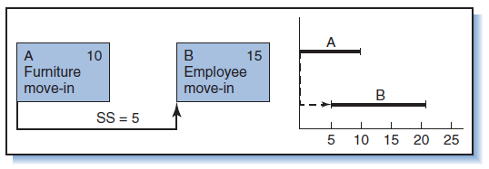
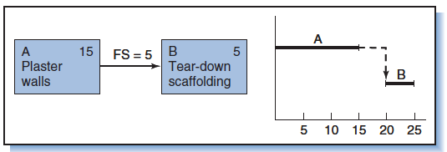
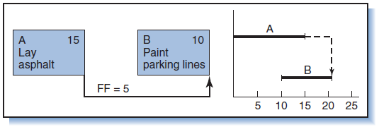
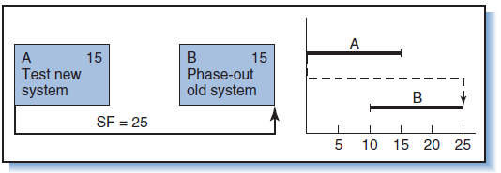
Start to start
Finish to start
Finish to finish
Start to finish

Slide 16
Applying Leads & Lags
Use leads and lags to support realistic and achievable project schedule.
Each activity is connected at least to one predecessor and one successor except the start and the end.
Leads.
May be added to start an activity before the predecessor activity is complete.
Lags
Inserted waiting time between activities
A
B
C
predecessor
Successor
A
A
Lags
Leads
B
B

Slide 17
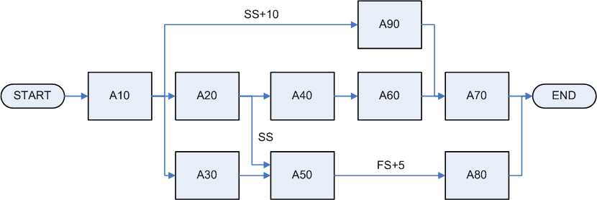
Precedence Diagramming Method (PDM)
Example of PDM which showing logical relationship and leads or lags
Other method to draw network diagram:
Arrow Diagramming Method (ADM)
GERT: allows loops between activities

Slide 18
Dependency Determination
To define sequence among activity, these type of dependency are used:
Mandatory (hard logic)
Inherent in the nature of work being done or required by the contract
E.g. You must design before you can develop
Discretionary (preferred, preferential, or soft logic)
Define base on knowledge
Can be changed if needed
Important when how to shorten or re-sequence the project
External
Based on the need t of the party outside the project
Internal
Based on the internal project team control
You must determine dependencies in order to use critical path analysis

Slide 19
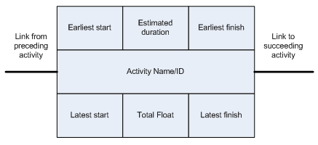
PDM
ES = Early Start
LS = Latest Start
EF = Early Finish
LF = Late Finish
EF = ES + D -1
LS = LF – D +1
Float (F) = LS – ES = LF – EF

Slide 20
Estimate Activity Resources
Process of estimating the type and quantities of material, people, equipment or supplies required to perform each activity.
Inputs
Schedule management plan Activity list Activity attributes Resource Calendars Risk Register Activity cost estimates Enterprise environmental factors Organizational process assets
Tools & Techniques
Expert judgment Alternatives analysis Published estimating data Bottom-up estimating Project management software
Outputs
Activity resource requirements Resource breakdown structure Project document updates

Slide 21
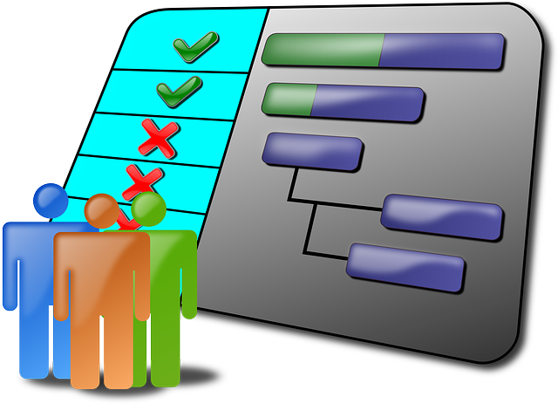
Estimate Activity Resource (Tools & Techniques)
Resource Calendar:
Information (skill, location, etc) in which resource (people, equipment, material, etc) are potentially available.
Published estimating data:
Use company’s rates
Bottom up estimating:
Activity is decomposed to be more confidence in estimating

Slide 22
Estimate Activity Durations
Process of approximating the number of work periods to complete individual activities with estimated resources. Schedule shall be as believable and realistic as possible (do not allow padding)
Inputs
Schedule Management plan Activity list Activity attributes Activity resource requirements Resource Calendars Project scope statement Risk Register Resource breakdown structure Enterprise environmental factors Organizational process assets
Tools & Techniques
Expert judgment Analogous estimating Parametric estimating Three-point estimates Group decision making techniques Reserve analysis
Outputs
Activity duration estimates Project document updates

Slide 23
Activity Duration Estimating
Duration includes the actual amount of time worked on an activity plus elapsed time
Effort is the number of workdays or work hours required to complete a task
Effort does not normally equal duration!
People doing the work should help create estimates, and an expert should review them

Slide 24
Estimate Activity Durations (Tools & Techniques)
Analogous Estimating (Top down):
use actual duration of previous activity (historical) that has similarity
Parametric Estimating:
use statistical relationship between historical data and other variables (e.g. learning curve)
The result can become heuristics (experience based technique/rule of thumb) Reserve analysis (buffer): includes contingency reserves

Slide 25
Program Evaluation and Review Technique (PERT)
PERT is a network analysis technique used to estimate project duration when there is a high degree of uncertainty about the individual activity duration estimates
PERT uses probabilistic time estimates
Duration estimates based on using optimistic, most likely, and pessimistic estimates of activity durations, or a three-point estimate

Slide 26
3-Points Estimate (PERT)
Also called Program Evaluation and Review technique (PERT)
Use for time and cost estimation
Expected calculated from Most-likely, Optimistic, Pessimistic
Range of estimate = EAD (Expected Activity Duration) +/- SD (Standard Deviation)
Standard deviation cannot be sum.
Variance used to calculate total SD of the project
Expected
Standard
Deviation
Variance

Slide 27
PERT Formula and Example
PERT weighted average =
optimistic time + 4X most likely time + pessimistic time
6
Example:
PERT weighted average =
8 workdays + 4 X 10 workdays + 24 workdays = 12 days 6
where optimistic time = 8 days
most likely time = 10 days, and
pessimistic time = 24 days
Therefore, you’d use 12 days on the network diagram instead of 10 when using PERT for the above example

Slide 28
Why Projects Are Often Late?
Many project managers estimate project duration and cost by simply adding up most likely estimates of activity durations and costs;
people procrastinate and waste available slack→student’s syndroms
Multitask contractor or vendor
Another reason for overruns is human behavior.
(tendering) stage of the project, champions and supporters do their best to “sell” the project→ Everyone is optimistic
it also leads to underestimating project duration and cost.

Slide 29
6.5 Develop Schedule
Inputs
Schedule Management plan Activity list Activity attributes Project schedule network diagram Activity resource requirements Resource Calendars Activity duration estimates Project scope statement Risk Register Project Staff asignment Resource Breakdown structure Enterprise environmental factors Organizational process assets
Tools & Techniques
Schedule network analysis Critical path method Critical chain method Resource optimization tehcniques Modeling tehcniques Applying leads and lags Schedule compression Scheduling tool
Outputs
Project schedule Schedule baseline Schedule data Project Calendar Project Management Plan update Project document updates

Slide 30
Gantt Charts
Gantt charts provide a standard format for displaying project schedule information by listing project activities and their corresponding start and finish dates in a calendar format
Symbols include:
Black diamonds: milestones
Thick black bars: summary tasks
Lighter horizontal bars: durations of tasks
Arrows: dependencies between tasks

Slide 31
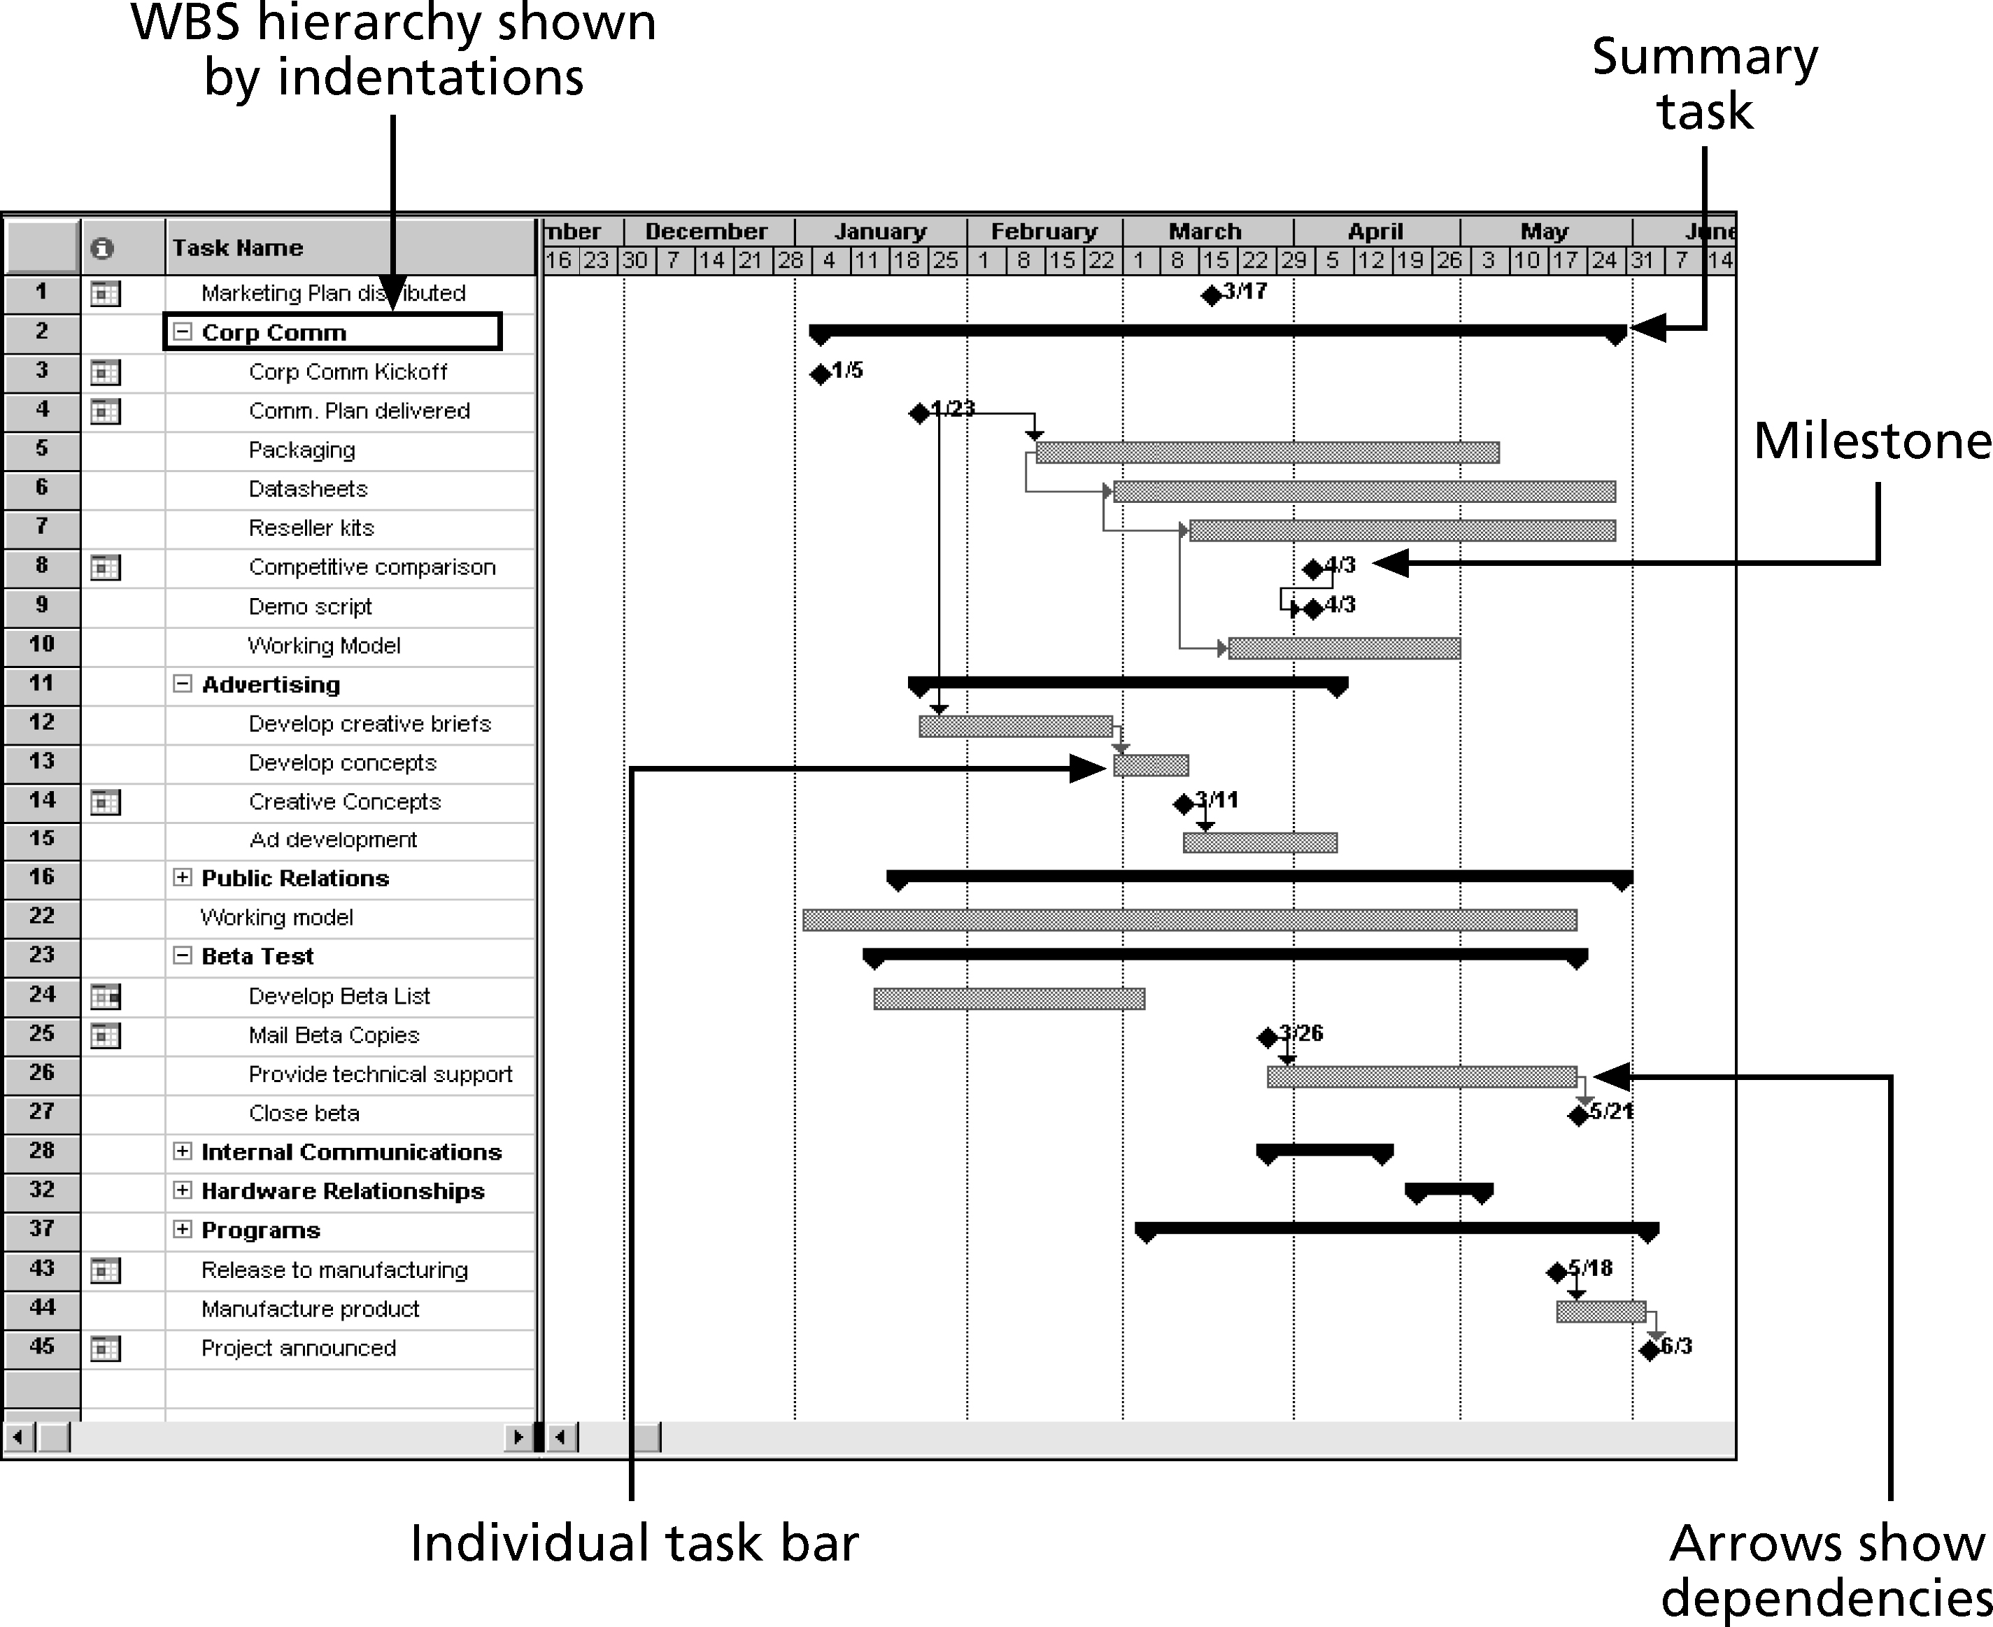
Gantt Chart for Software Launch Project

Slide 32
Adding Milestones to Gantt Charts
Many people like to focus on meeting milestones, especially for large projects
Milestones emphasize important events or accomplishments on projects
Normally create milestone by entering tasks with a zero duration, or you can mark any task as a milestone

Slide 33
Critical Path Method (CPM)
CPM is a network diagramming technique used to predict total project duration
A critical path for a project is the series of activities that determines the earliest time by which the project can be completed
The critical path is the longest path through the network diagram and has zero amount of slack or float
Slack or float is the amount of time an activity may be delayed without delaying a succeeding activity or the project finish date
There can be more than one critical path if the lengths of two or more paths are the same
The critical path can change as the project progresses

Slide 34
Critical Path
Critical Path is the longest duration path
Identify the shortest time needed to complete a project
There can be more than one critical path
We don’t want critical path, it increase risk
Don’t leave a project with a negative float, you would compress the schedule
Near-critical path is the path that has close in duration to critical path
Float (Slack)
Total float: the amount of time an activity can be delayed without delaying the project end date or intermediary milestone.
Free float: the amount of time an activity can be delayed without delaying the early start date of its successor(s).

Slide 35
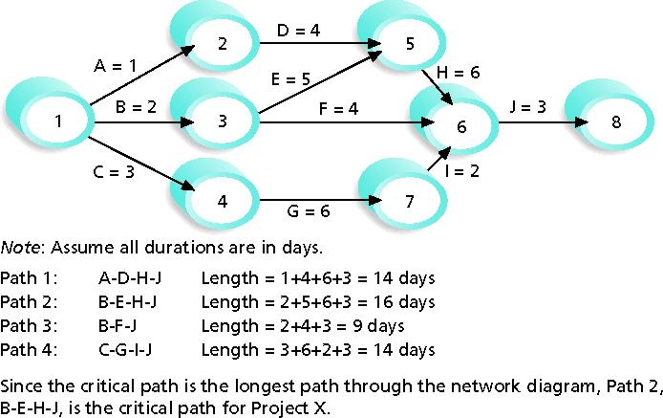
Determining the Critical Path for Project X

Slide 36
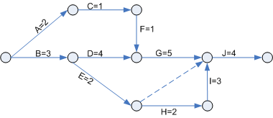
Critical Path Method Basic
Activity | Precedence | Duration
A |  | 2
B |  | 3
C | A | 1
D | B | 4
E | B | 2
F | C | 1
G | D,F | 5
H | E | 2
I | H | 2
J | G,I,E | 0
K
Dummy activity = 0 resource & 0 duration
Critical activities
all activities in the critical path
Delay in the completion of these activities will lengthen the project timescale
Has float = 0

Slide 37
Critical Path using PDM
Forward Pass
Backward Pass
Calculation
Forward Pass:
ES + D = ES(successor)
use highest value on join
Backward Pass:
LS – D (predecessor) = LS (predecessor)
Use lowest value on join

Slide 38
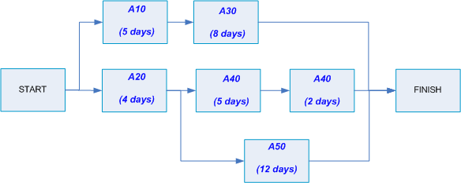
Exercise
Questions:
What is the critical path?
What is critical path duration?
What is float (slack) duration of activity A30?
Answers:
-
-
-

Slide 39
Critical Chain Scheduling
Critical chain scheduling
A method of scheduling that considers limited resources when creating a project schedule and includes buffers to protect the project completion date
Uses the Theory of Constraints (TOC)
A management philosophy developed by Eliyahu M. Goldratt and introduced in his book The Goal
Attempts to minimize multitasking
When a resource works on more than one task at a time

Slide 40
Multitasking Example

Slide 41
Buffers and Critical Chain
A buffer is additional time to complete a task
Murphy’s Law states that if something can go wrong, it will
Parkinson’s Law states that work expands to fill the time allowed
In traditional estimates, people often add a buffer to each task and use it if it’s needed or not
Critical chain scheduling removes buffers from individual tasks and instead creates:
Project buffers or additional time added before the project’s due date
Feeding buffers or additional time added before tasks on the critical path

Slide 42
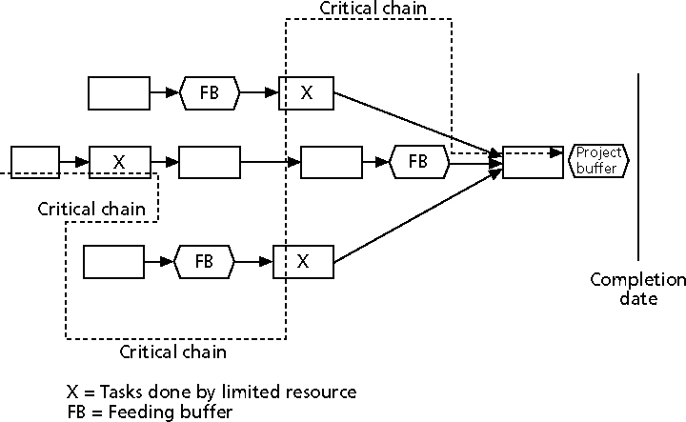
Example of Critical Chain Scheduling

Slide 43
Schedule Compression
Fast Tracking
Performing critical path activities in parallel.
Usually increase risk and requires more attention to communication.
May need a rework.
E.g. Design is half finished and start coding.
Crashing
Analyze cost and schedule trade-offs.
Determine most compression for least cost.
Crash the tasks that cost the least first, focusing on minimizing project cost.
Always results in increased cost.
Notes:
Revise this slide!

Slide 44
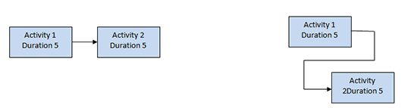
Fast track
Before fast tracking
(total time 10)
After fast tracking
(total time 8)
Crashing

Slide 45
Project Schedule
Schedule can be shown with or without dependencies (logical relationship).
Presented as
Summary form e.g. Master Schedule, Milestone schedule
Detailed form
Format:
Network diagram
Milestone chart
Bar chart (Gantt chart)

Slide 46
Schedule Data
Includes at least:
Schedule milestone
Schedule activities
Activity attributes
Assumptions & Constraints
Additional information can be added, such as
Resource histograms
Cash-flow projections
Order & delivery schedules
Alternative schedules

Slide 47
Control Schedule
Inputs
Project Management Plan Project Schedule Work performance data Project calendars Schedule data Organizational process assets
Tools & Techniques
Performance reviews Project Management Software Resource optimization techniques Modeling techniques Adjusting leads & lags Schedule compression Schedule tooling
Outputs
Work performance information Schedule forecasts Organizational process assets updates Change requests Project management plan updates Project document updates

Slide 48
Schedule Control Suggestions
Perform reality checks on schedules
Allow for contingencies
Don’t plan for everyone to work at 100% capacity all the time
Hold progress meetings with stakeholders and be clear and honest in communicating schedule issues

Slide 49
Controlling the Schedule
Goals are to know the status of the schedule, influence factors that cause schedule changes, determine that the schedule has changed, and manage changes when they occur
Tools and techniques include:
Progress reports
A schedule change control system
Project management software, including schedule comparison charts like the tracking Gantt chart
Variance analysis, such as analyzing float or slack
Performance management, such as earned value (Chapter 7)

Slide 50
Reality Checks on Scheduling
First review the draft schedule or estimated completion date in the project charter
Prepare a more detailed schedule with the project team
Make sure the schedule is realistic and followed
Alert top management well in advance if there are schedule problems

Slide 51
Two Methods to Calculate the Forward and Backward Passes in a Network Diagram
Zero Method assumption:
All starts and ends are at the end of a time period.
One Method assumption:
All starts are at the beginning of a time period, and all finishes are at the end of a time period.

Slide 52
Contoh Soal!

Slide 53
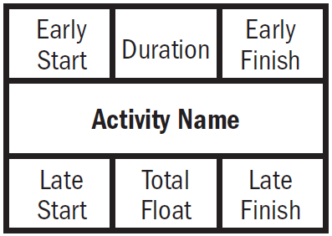
A
B
ES
D
EF
ES
D
EF
LS
TF
LF
LS
TF
LF

Slide 54
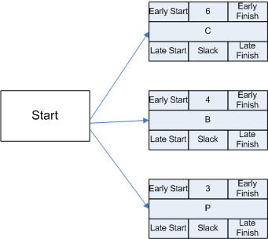

Slide 56
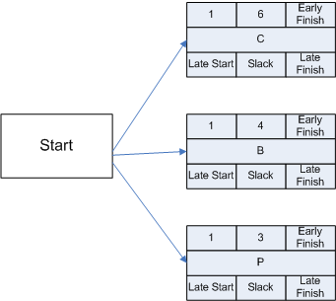
Forward Pass
EF= ES + D - 1

Slide 57
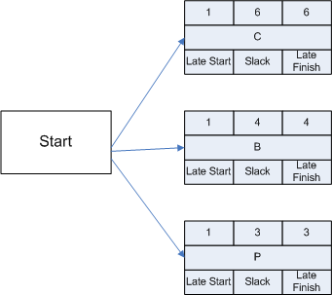
"1" + "6" -1 = 6
"1" + “4" -1 = 4
"1" + “3" -1 = 3

Slide 58
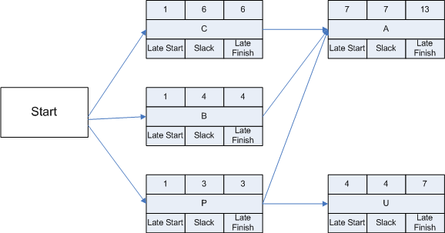
Ambil yang terbesar lalu ambahkan “1”
6
“7" + “7" -1 =13
4
3
“4" + “4" -1 =7

Slide 60
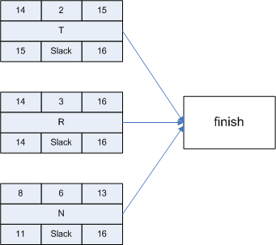
“16" - “2" +1 = 15
“16" – “3" +1 = 14
Backward Pass
LS= LF - D + 1
“16" – “6" +1 = 11

Slide 61
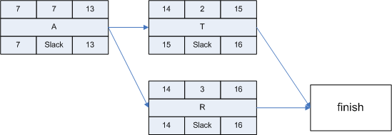
Ambil yang terkecil lalu kurangi “1” (14-1= “13”)
15
“13" – “7” +1 = 7
14

Slide 63
Apa bedanya?
You are using the Zero Method if:
The finish is the same number as the start of the next activity on your critical path.
You are using the One Method if:
You increased the finish number by one to calculate the start of the next activity on your critical path.

Slide 64
How to Shorten the Project Schedule
1. Allocating more resources or by changing their scope
2. Crashing
is a technique for making cost and schedule trade-offs to obtain the greatest amount of schedule compression for the least incremental cost. (DisAdv.: often increases total project costs).
3. Fast tracking
involves doing activities in parallel that you would normally do in sequence. (DIsAdv.: often increases project risk and results in rework.)

