Slide 1
Resource Scheduling Part 1
Project Management

Slide 2
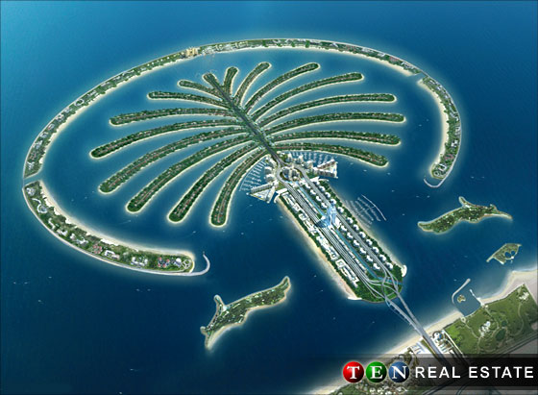
Brainsorming : The palm jumeirah, Dubai 2006

Slide 3
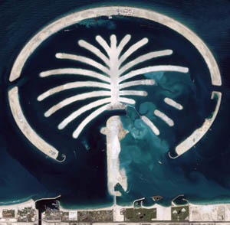
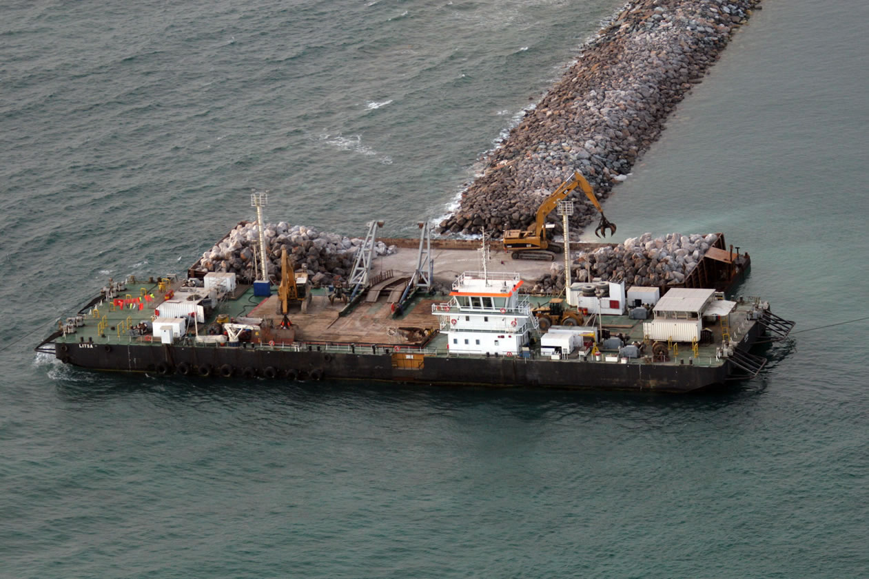
Mega project of making a man-made island

Slide 4
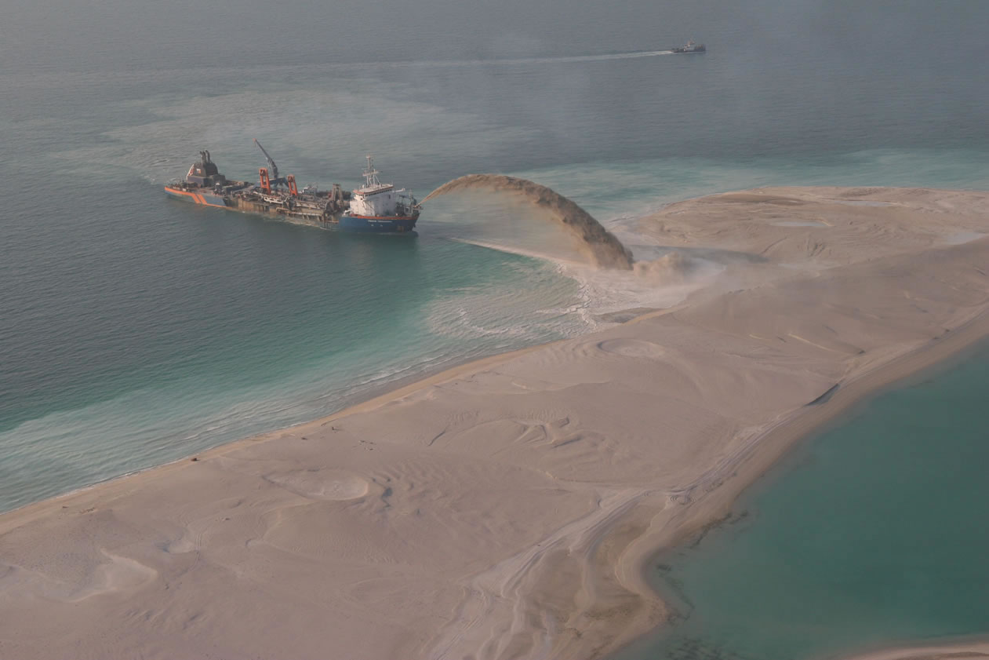

Slide 5
The questions
how much money spent?
How much sand spread out?
How many workers do we need?
How many ships used?
Are they used economically?

Slide 6
Abundant resources make the project fast completion, but very costly (budget cost) and vice versa
Insufficient resources → over schedule→over budget
ahead-schedule
Low budget
On time project
Over schedule
Over budget

Slide 7
Some resources are assigned to multiple tasks
Reallocated , adjusted, no longer overallocated
the overallocated resource works on tasks consecutively, instead of simultaneously.
Utilization and availability

Slide 8
Resource scheduling is a tool for allocating the resources of project in economic terms
machine
cost
Human

Slide 9
Why do we need?
As project managers, are given the finish date of the project before we even have a chance to plan for it (Domingues)
Schedules should be evaluated not merely in terms of meeting project milestones, but also in terms of the timing and use of scarce resources.

Slide 10
the tasks will have to be rescheduled concurrently or even sequentially to manage the constraints
physical
technological
resource
Nicholas
Gray & Larson 2005

Slide 11
relationship between time use and resource in resource allocation
Resource Limited: The project must be finished as soon as possible, but without exceeding some specific level of resource usage or some general resource constraint
Time Limited: The project must be finished by a certain time, using as few resources as possible. But it is time, not resource usage, that is critical

Slide 12
Resource Leveling (Smoothing)
Resource leveling aims to minimize the period-by-period variations in resource loading by shifting tasks within their slack allowances.
The purpose is to create a smoother distribution of resource usage.
with a smooth increase at the beginning of a project and a smooth decrease at the end.

Slide 13
The objectives of resource leveling
Resource leveling, referred to as resource smoothing, has two objectives:
To determine the resource requirements so that they will be available at the right time,
To allow each activity to be scheduled with the smoothest possible transition across usage levels

Slide 14
2 types of leveling resources
By delaying a task until the assigned resource has time to work on it.
By splitting a task so that part of a task is done when planned and the rest of it is done later when the assigned resource has time.

Slide 15
example
normal
delayed
splitted

Slide 16
Resource Levelling Heuristic
Resource management is a multivariate, combinatorial problem, i.e. multiple solutions with many variables, the mathematically optimal solution may be difficult or infeasible.
More common approach to analyzing resource leveling problems is to apply some resource leveling heuristics.

Slide 17
The steps
List the accurate and complete WBS
Create a project activity network diagram
identify the most critical tasks
By starting with the most important tasks first, the chance for successful project management is more likely

Slide 18
The steps
Create a table showing the resources required for each activity, durations, and the total float available
Plot into gant chart
Check to see how many hours is available per team member for work then determine how many hours have been allocated to each person.

Slide 19
The steps
If the number of hours allocated is above what is available they are over-allocated.
Develop a time-phased resource loading table
Identify any resource conflicts and begin to smooth the loading table using one or more heuristics

Slide 20
Tasks should then be adjusted so that the number of required work hours are equivalent to the number of hours available.
Once this has been accomplished the critical project resources have been leveled. Next, do the same with the non-critical tasks.

Slide 21
example
activity | predecessor | resource | duration
A | - | 6 | 4
B | A | 2 | 1
C | A | 2 | 3
D | B | 7 | 4
E | D | 3 | 2
F | E,C | 6 | 1
Resource limit is set at 8 hourly unit per day

Slide 22
Draw project network

Slide 23
Produce the table showing ES,LS EF,LF TF
activity | res | duration | ES | LS | EF | LF | TF
A | 6 | 4 | 0 | 0 | 4 | 4 | 0
B | 2 | 1 | 4 | 4 | 5 | 5 | 0
C | 2 | 3 | 4 | 4 | 11 | 11 | 4
D | 7 | 4 | 5 | 5 | 9 | 9 | 0
E | 3 | 2 | 9 | 9 | 11 | 11 | 0
F | 6 | 1 | 11 | 11 | 12 | 12 | 0
Critical path is A-B-D-E-F

Slide 24
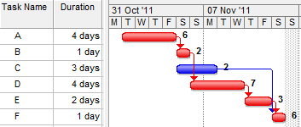
Plot into Gantt chart
Using dependency and interdependency diagram

Slide 25
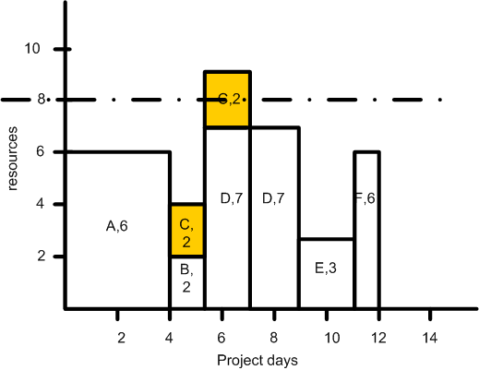
Resource imbalance

Slide 26
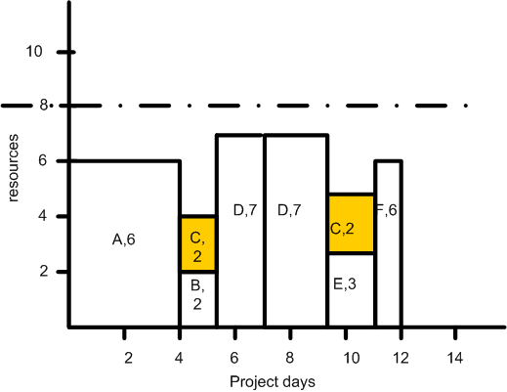
Task splitted

Slide 27
Resource Loading Chart
Delayed task
8
6
Resources
Resource imbalance
4
A
D
F
B
2
E
C
2
4
6
8
10
12
14
Project Days

Slide 28
Summary
Period | Resource requirement | levelling
0-4 | 6 | 6
4-5 | 4 | 4
5-7 | 9 | 7
7-9 | 7 | 7
9-11 | 3 | 5
11-12 | 6 | 6

