Slide 1
OBJECTIVE OF FACILITY
PROCESS, PRODUCT, SCHEDULE

Slide 2
V
1
Define and redefine the objective
9
2
Maintain and adapt
Specify the primary and support activity
8
3
implement
facility
plan
Determine the interrelationship
Sistematika FP
7
Select
facility
plan
4
Determine the space requirement
5
6
Evaluate
alternative facility
plan
Generate facility
plan

Slide 3
Considerations Before Alternative Facility Plans
What is to be produced ?
How are the products to be produced?
When are the products to be produced ?
How much of each product will be produced ?

Slide 4
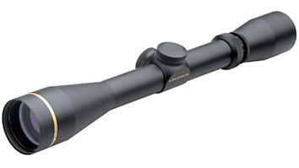
Considerations Before Alternative Facility Plans
For how long will the products be produced?
Where are the products to be produced ?
Global sourcing : Boeing, Leupold & Stevens

Slide 5
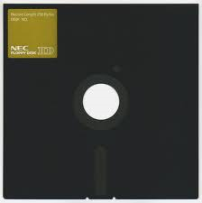
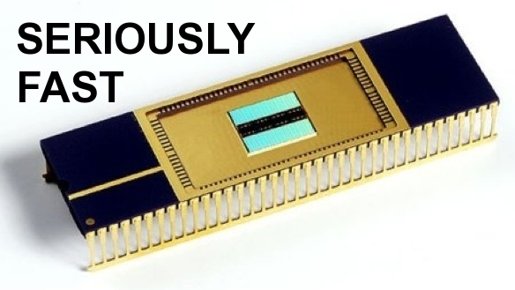
intermezzo
1970
1980
1998
2016
Substitute ?

Slide 6
intermezzo
Airbus A320 → Prancis
Boeing 737 → USA
PT DI→ sayap

Slide 7
schedule
process
Product
Facility planning

Slide 8
Product , Process , and Schedule Design
Product Design
Facilities Design
Process Design
Schedule Design

Slide 9
Product Design
Determining a product will be produced including a detail product components.
Defining type of product
Tools& technique → QFD, benchmarking
Production Data:
Blue print komponen
Part list
Production routing
Output→assembly drawing

Slide 10
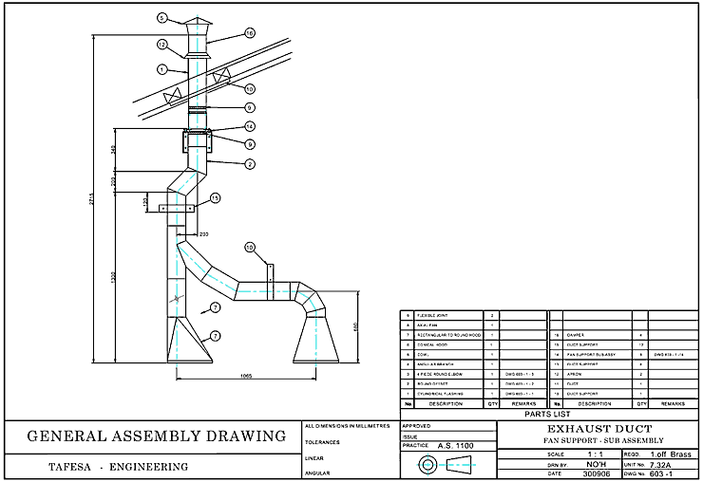
Example: assembly drawing
Using technical drawing standards

Slide 11
Example: part list

Slide 12
Production data
Number of component including their number of process
Name of the components
Number of components
Specification of components
Price every components
Source of components

Slide 13
Process Design
Determining how a product will be produced
Process design is created to identify the flow of material handling
Production data for material handling :
the path through which the materials flow in between departments
Volume of the moved product
Traveling distance
Frequency of material movement
Speed of movement
Cost every moving material

Slide 14
Design Process Tool
operation process chart (OPC)
assembly chart
flow process chart
flow chart
from to chart
Multiple Product Process Chart (MPPC)
Route Sheet
Acrivity Relationship Chart
STANDAR ASME

Slide 15
Process Design Consideration
Determining end to end process
Determining the right step of each operation
Select effective and efficient alternative
Set production standard for instance standard time per product etc

Slide 16
Schedule design
Schedule design should meet when the product will be produced and how long the product is being produced
Information from marketing department will be used for scheduling the production
Schedule design will be useful for deciding the facility for instance: selecting machine that will be used, number of operator shift, number of operator will be worked, size of plant etc

Slide 17
THANK YOU…

