Slide 1
Facility Planning Systematics Process

Slide 2
review

Slide 3
Facilities
Proper facilities planning along the supply chain ensures that the product will be manufactured and shipped to the satisfaction of the ultimate customer.

Slide 4
characteristic
Flexibility
Modularity
Upgradibility
Adaptability
Selective operability
Environtmental and energy friendliness

Slide 5
Flexibility.
Flexible facilities are able to handle a variety of requirements without being altered

Slide 6
Modularity. Modular facilities are those with systems that cooperate efficiently over a wide range of operating rates.

Slide 7
Upgradability. Upgraded facilities gracefully incorporate advances in equipment systems and technology

Slide 8
Adaptability. This means taking into consideration the implications of calendars, cycles, and peaks in facilities use

Slide 9
Selective Operability. This means understanding how each facility segment operates and allows contingency plans to be put in place.

Slide 10
Environmental and energy friendliness

Slide 11
Holistic Approach to Create Such Facilities
Total Integration – the integration of material and information flow in a true, top-down progression that begins with the customer.

Slide 12
Holistic Approach to Create Such Facilities

Slide 13
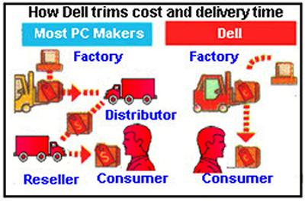
Holistic Approach to Create Such Facilities
Blurred boundaries –
The elimination of the traditional customer/supplier and manufacturing/warehousing relationships, as well as those among order entry, service, manufacturing, and distribution

Slide 14
Holistic Approach to Create Such Facilities
Consolidation – the merging of similar and disparate business entities that results in fewer and stronger competitors, customers, and suppliers.
Consolidation also includes the physical merging of sites, companies, and functions.

Slide 15
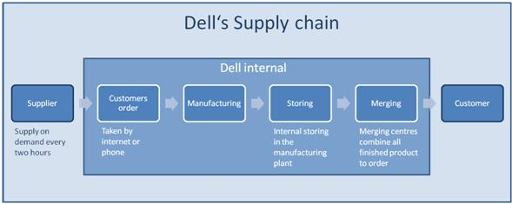

Slide 16
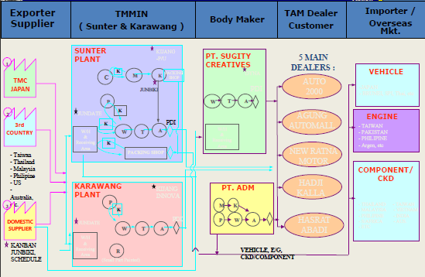

Slide 17
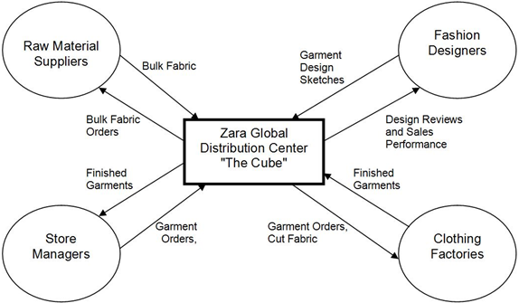
Holistic Approach to Create Such Facilities
Reliability – the implementation of robust systems, redundant systems, and fault-tolerant systems to create a very high levels of uptime.

Slide 18
Holistic Approach to Create Such Facilities
Maintenance – a combination of preventive and predictive maintenance.
Preventive maintenance is a continuous process that minimize future maintenance problems.
Predictive maintenance anticipates potential problems by sensing the operations of a machine or system

Slide 19
Holistic Approach to Create Such Facilities
Economic progressiveness – the adoption of innovative fiscal practices that integrate scattered information into a whole that may be used for decision making

Slide 20
Considerations
What impact does facilities planning have on :
Handling and maintenance cost?
Employee morale, and how does employee morale impact operating cost?
The management of Facility?
A facility’s capability to adapt to change and satisfy future requirements?

Slide 21
Background
Using engineering design process to make systemathic approach of facility planning
Give a guidance for facility planning
Valid both designing new facility or redesign the existing facility

Slide 22
To design something resemble to cook something
We need “a recipe” to conduct it

Slide 23
Sistematika FP
1
Define and redefine the objective
9
2
Maintain and adapt
Specify the primary and support activity
8
3
implement
facility
plan
Determine the interrelationship
7
Select
facility
plan
4
Determine the space requirement
5
6
Evaluate
alternative facility
plan
Generate facility
plan

Slide 24
1. Define or redefine the objective the facility planning
Define the goals of facility planning wether designing a new-fresh facility or redesign the existing facility
How?
Understand the successful model of organization
Interpret the internal issues
Interpret the external issues

Slide 25
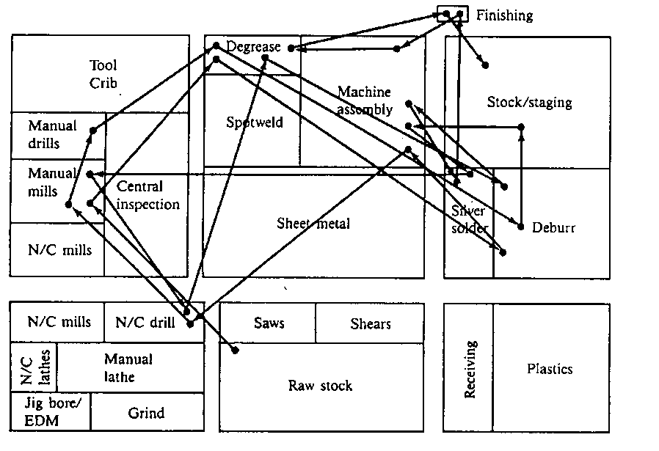
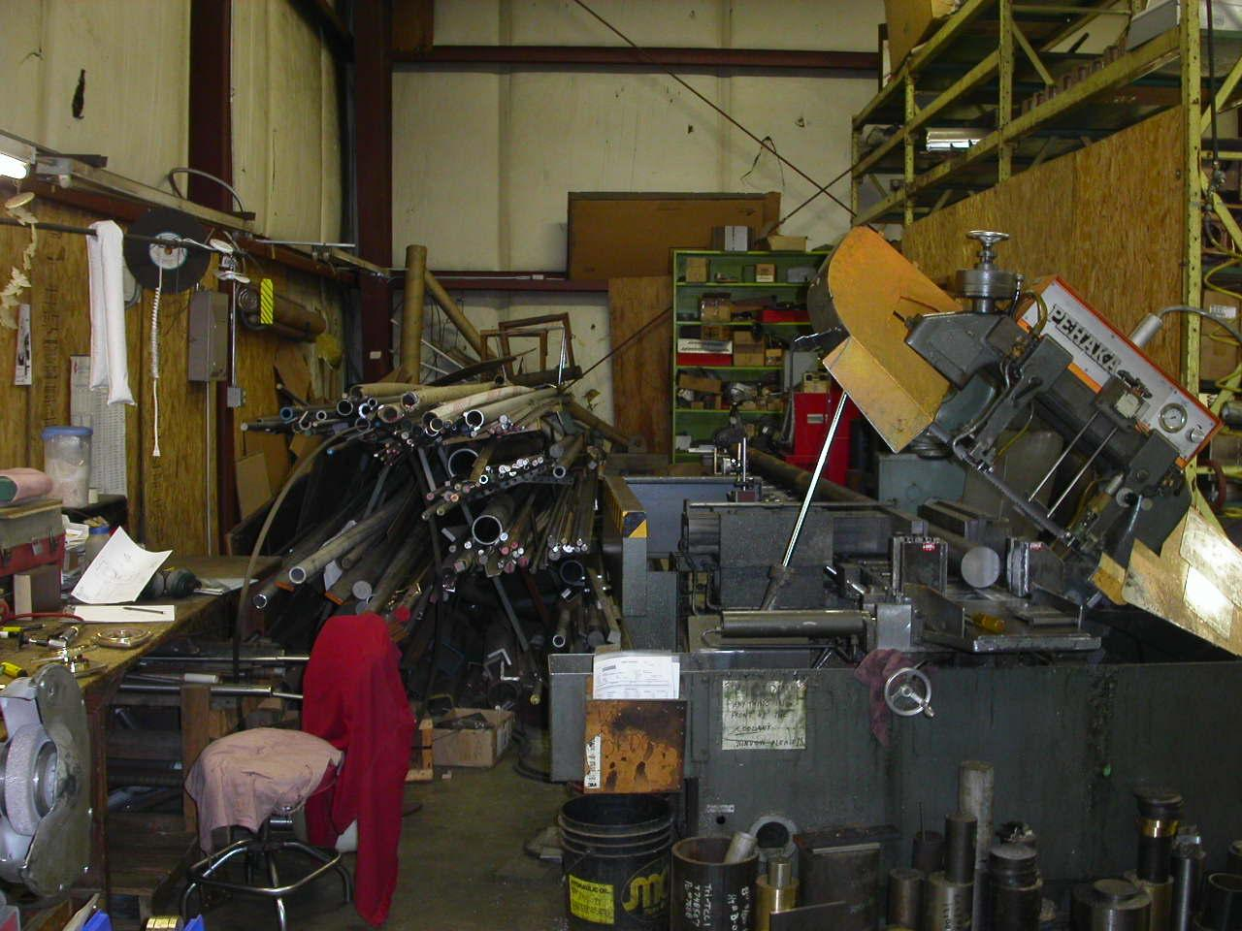
Re-design
Symptoms that allow us to detect the need for a re-layout:
Congestion and bad utilization of space.
Excessive stock in process at the facility.
Long distances in the work flow process.
Simultaneous bottle necks and workstations with idle time.
Qualified workers carrying out too many simple operations.
Labor anxiety and discomfort. Accidents at the facility.
Difficulty in controlling operations and personnel.

Slide 26
2. Specify the primary and support activities
Primary activites → the core operation
Support activites→ supporting the primary activites not to be interupted or delayed
E.g : maintenance is the supporting activity of manufacture

Slide 27
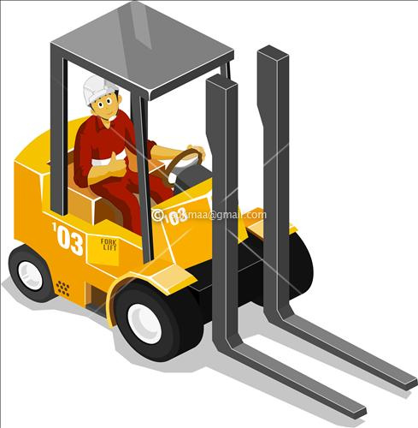
3. Determine the interrelationship among all activities
A department which has close relationship to another department will be positioned closely to make efficient flow of process.

Slide 28
4. Determine the space requirement
Determining space requirement based on tools, operator and material.
Consider all equipment, material, and personnel requirements

Slide 29
5. Generate alternative facility plan
Design of facility include alternative layout structural design and material handling system.

Slide 30
6. Evaluate alternatives facilities plan
Browse the impact of using those alternatives, visualize the interaction and sort by the benefits
Evaluate alternative facilities plan. On the basis of accepted criteria, rank the plan specified.

Slide 31
7. Select a facilites plan
8. implement the facilites plan
9. Maintain and adapt

Slide 32
Facilities Planning Process
Specify/Update Primary and related activities to accomplish objectives
Determine Space requirements for all activities
Maintain and Continuously improve
Determine Facility Location
What’s The feasability of incorporating the new oeration or facility on existing site?
Not Feasible
Feasible
Develop alternative plans and evaluate
Select facilities plan
Implement plan

