Slide 1
PENYUSUNAN PROPOSAL ILMIAH IEH4E2
Program Studi Teknik Industri
Fakultas Rekayasa Industri
Telkom University

Slide 2
CITATION, QUOTATION, AND REFERENCING
A guide to referencing with examples in the Harvard styles,
University of Canberra Library & Academic Skills Program 2010

Slide 3
INTRODUCTION (1)
Citation is the practice of referring to the work of other authors in the text of your own piece of work. Such works are cited to show evidence both of the background reading that has been done and to support the content and conclusions.
Each citation requires a reference at the end of the work; this gives the full details of the source item and should enable it to be traced.
Other reasons for accurate citation and referencing are:
To give credit to the concepts and ideas of other authors.
To provide the reader (often the marker/examiner of the assignment) with evidence of the breadth and depth of your reading.
To enable those who read your work to locate the cited references easily.

Slide 4
INTRODUCTION (2)
Plagiarism is the submission of an item of assessment containing elements of work produced by another person(s) in such a way that it could be assumed to be the student’s own work. Examples of plagiarism are:
the verbatim copying of another person’s work without acknowledgement
the close paraphrasing of another person’s work by simply changing a few words or altering the order of presentation without acknowledgement
Copying or close paraphrasing with occasional acknowledgement of the source may also be deemed to be plagiarism if the absence of quotation marks implies that the phraseology is the student’s own.

Slide 6
IN-TEXT REFERENCES (1)
Harvard uses the ‘author-date’ style of referencing. That is, in-text references (generally) appear in the following format:
(Author’s Last Name Year of Publication, Page Number(s))
Example: (Austen 1813, p. 64)

Slide 7
IN-TEXT REFERENCES (2)
You are also permitted to include the author’s name in a sentence, omitting it from the brackets.
Example: Austen (1813, p. 64-67) observes that…

Slide 8
IN-TEXT REFERENCES (3)
When citing a source you have not read yourself, but which is referred to in a source you have read, use the following method:
Moore (as cited in Maxwell 1999, p. 25) stated that…
Important: You would cite Maxwell, not Moore, in the Reference List
Please Note: It is always preferable to cite the original source

Slide 9
REFERENCE LIST (1)
The reference list should appear at the end of your work on a separate page
Only include references you have cited in your work
References should be listed in alphabetical order
All references should have a hanging indent. That is, all lines of a reference subsequent to the first should be indented

Slide 10
Example of Harvard Referencing Style

Slide 11
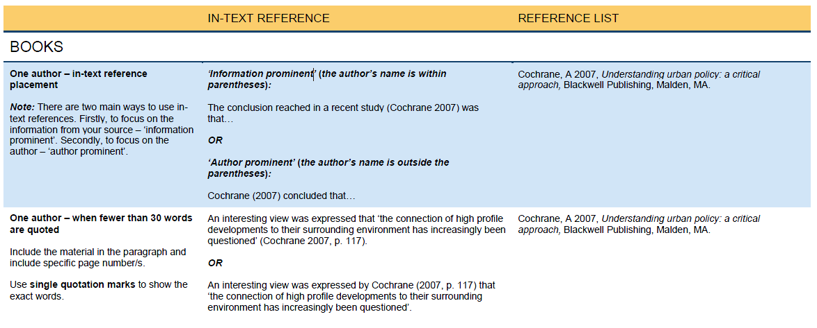

Slide 12
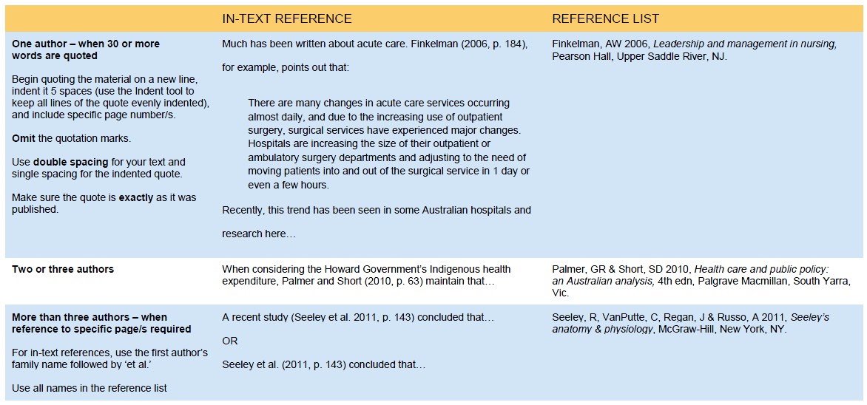

Slide 13
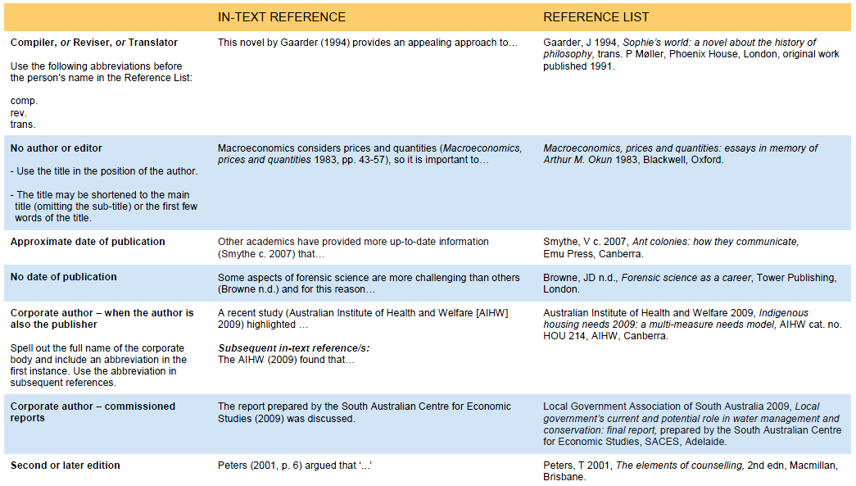

Slide 14
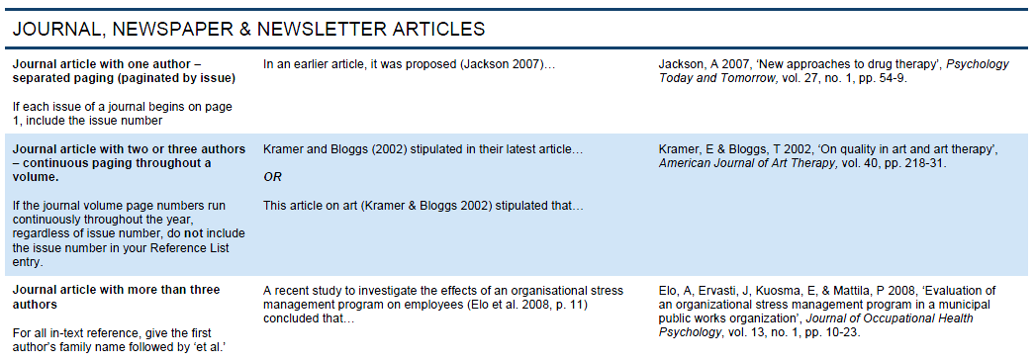

Slide 15
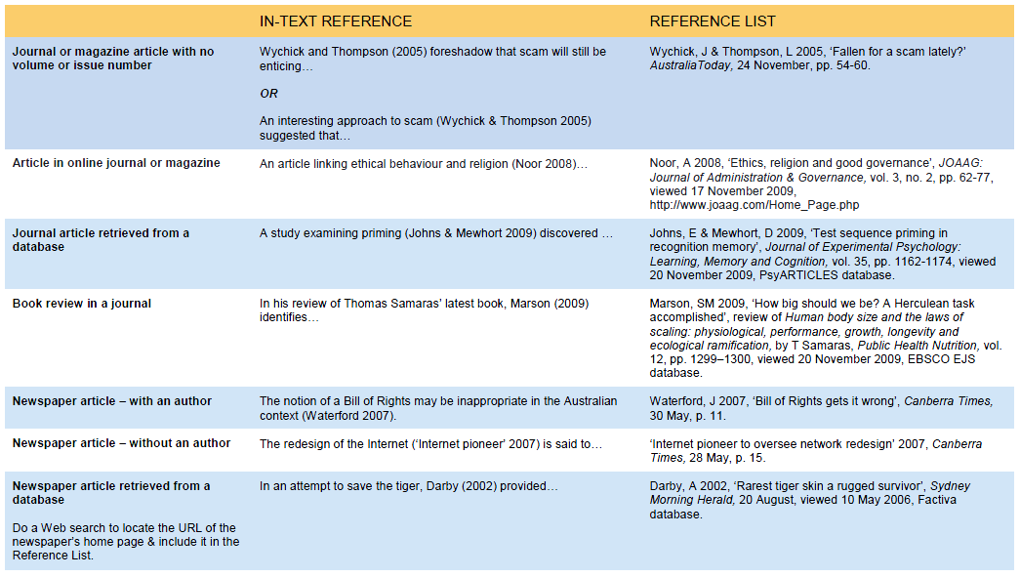

Slide 16
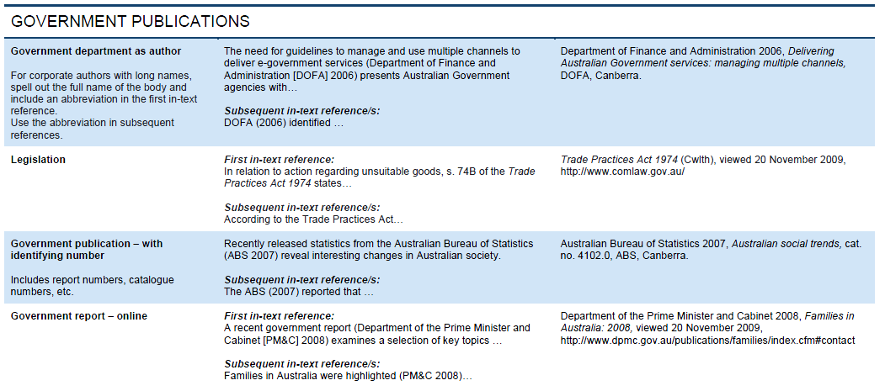

Slide 18
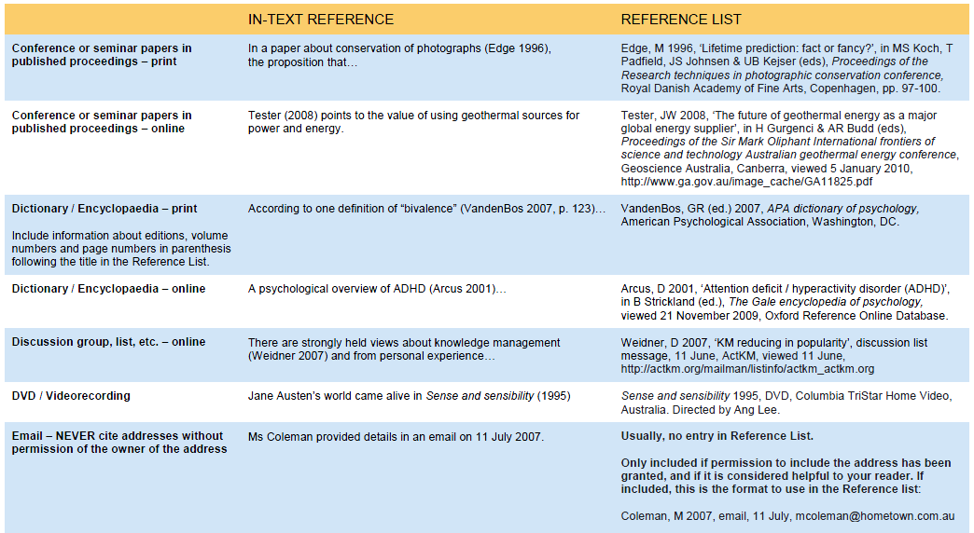

Slide 19
CITATION, QUOTATION, AND REFERENCING
A guide to referencing with examples in the APA styles,
University of Canberra Library & Academic Skills Program 2010

Slide 20
INTRODUCTION
The American Psychological Association referencing style (or APA as it is more commonly known) is used across a variety of disciplines. The sixth and latest edition was published in 2010.

Slide 21
IN-TEXT REFERENCES (1)
APA uses the ‘author-date’ style of referencing. That is, in-text references (generally) appear in the following format:
(Author’s Last Name, Year of Publication, Page Number(s)).
Example: (Austen, 1813, p. 64).

Slide 22
IN-TEXT REFERENCES (2)
You are also permitted to include the Author’s name in a sentence, omitting it from the brackets.
Example: Austen (1813, pp. 64-67) observes that…
Note: For multiple pages, use the abbreviation ‘pp.’ Include the full page range, i.e. ’64-67’ as opposed to ’64-7’.

Slide 23
IN-TEXT REFERENCES (3)
When directly quoting from a source, you must include page number(s) and enclose the quote in double quotation marks.
Example: “A woman must have money and a room of her own if she is to write fiction” (Woolf, 1929, p. 6).

Slide 24
IN-TEXT REFERENCES (4)
When paraphrasing or referring to an idea contained in another work,
the Publication manual of the American Psychological Association advises: “you are encouraged to provide a page or paragraph number, especially when it would help an interested reader locate the relevant passage in a long or complex text” (American Psychological Association [APA], 2010, p. 171).
It is recommended you verify this advice with your unit of study coordinator, lecturer or tutor for each subject.

Slide 25
IN-TEXT REFERENCES (5)
When citing a source you have not read yourself, but which is referred to in a source you have read (also known as ‘secondary referencing’), use the following method:
Moore (as cited in Maxwell, 1999, p. 25) stated that…
Important: You would cite Maxwell, not Moore, in the Reference List.
Note: It is always preferable to cite the original source.

Slide 26
REFERENCE LIST (1)
The Reference List should appear at the end of your work on a separate page.
Only include references you have cited in your work.
All references should have a hanging indent. That is, all lines of a reference subsequent to the first line should be indented
In general, references should be listed alphabetically by the last name of the first author of each work.
Special Reference List cases:
In the case of works by different authors with the same family name, list references alphabetically by the authors’ initials.
In the case of multiple works by the same author in different years, list references chronologically (earliest to latest).
In the case of multiple works by the same author in the same year, list references alphabetically by title in the Reference List.

Slide 27
REFERENCE LIST (2)
When referring to Books, Book Chapters, Article Titles or Webpages, capitalise only the first letter of the first word of a title and subtitle, and proper nouns.
Example: Aboriginals and the mining industry: Case studies of the Australian experience
When referring to Journal Titles, capitalise all major words (do not capitalise words such as ‘of’, ‘and’, & ‘the’ unless they are the first word in the title).
Example: Journal of Exercise Science and Fitness

Slide 28
Example of APA Referencing Style

Slide 29
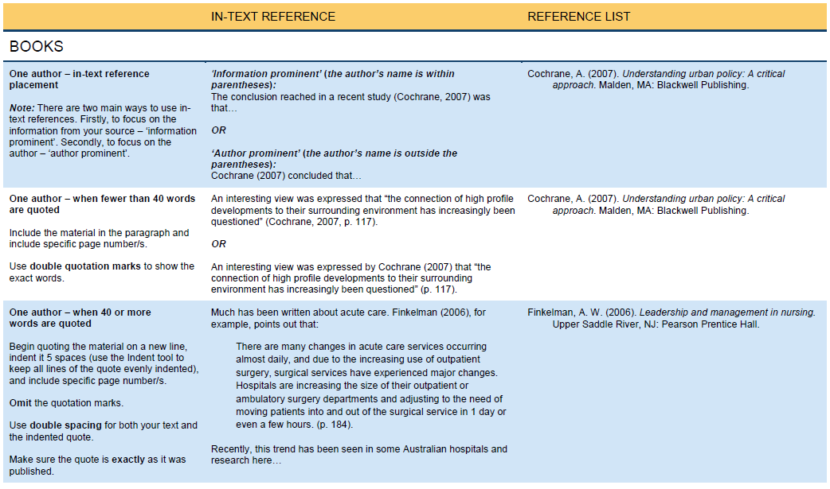

Slide 30
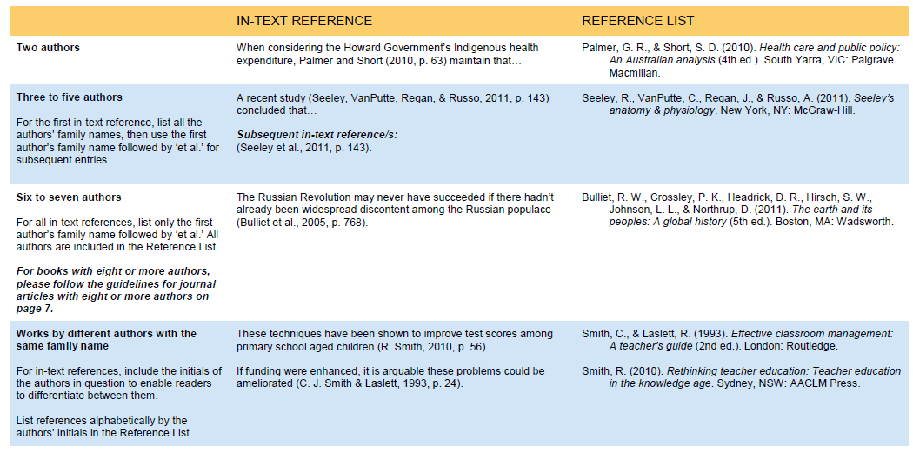

Slide 31
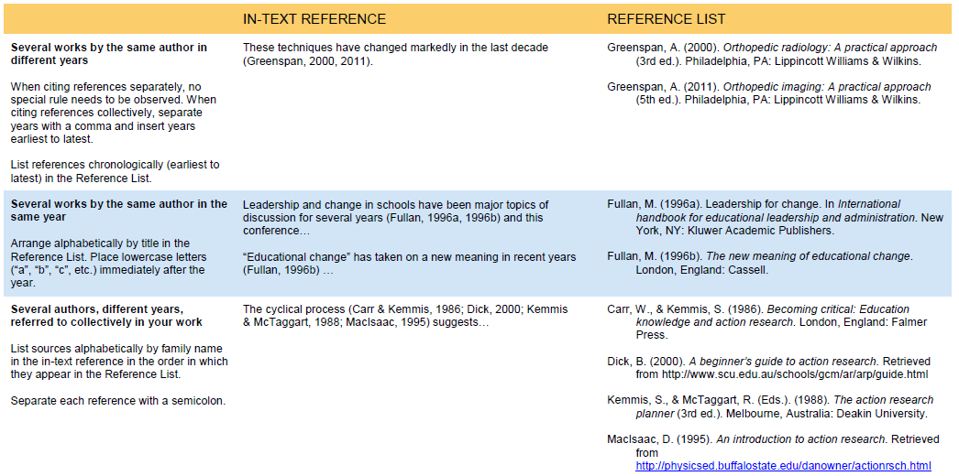

Slide 32
Differences between APA and Harvard referencing style

Slide 33
Harvard
APA
The list of references included at the end of a document is named “Reference List”
The list of references included at the end of a document is named “References”

Slide 34
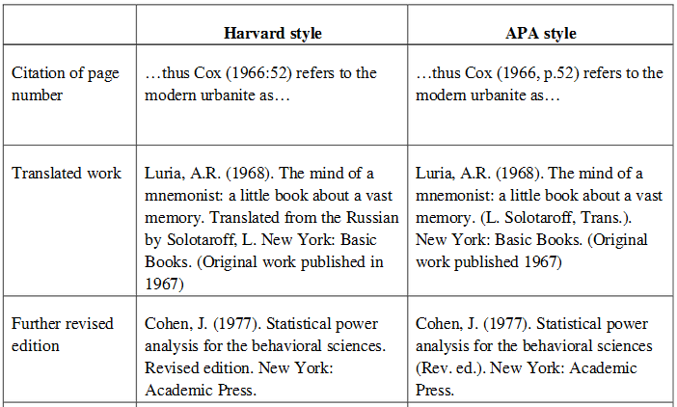

Slide 35
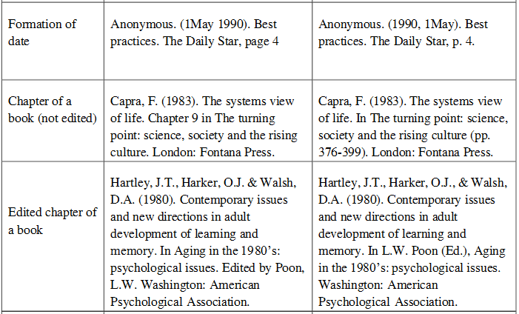

Slide 37
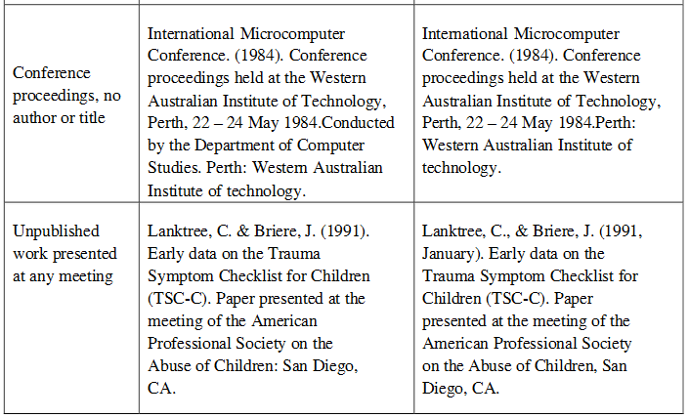

Slide 38
Thanks….

